Slide 1
Modeling delay degradation due to NBTI in FPGA Look-Up Tables
Mohammad NAOUSS, François MARC
Notes:
Thank you mr chair man, Good afternoon everybody. I am here to present my work intitule “Modeling delay degradation due to NBTI in FPGA Look-Up Tables”.

Slide 2
Introduction
Challenges
Challenges
High cost characterization for modeling the circuits reliability
The simulations methods are not enough to model a real application
The limited access to the novel technologies internal structures
Objectives
Measure the evolution of functional parameter of the gates depending on :
the time
the operating conditions.
Identify the mechanism responsible of the aging
Modeling the degradation caused by this mechanism
Notes:
The characterization for modeling the reliability of digital integrated circuit is an expensive operation. And the simulations methods need a measurement results to validate the model of a real application. In addition we are limited to access to the internal structure of the novel technology to develop a real model, in our case we can not have an access to the structure of LUT.
For these reasons the objectives of this work is to measure the delay degradation depending on the time and the operating conditions then identify mechanism responsible in order to model his effect to the timing of LUT.

Slide 3
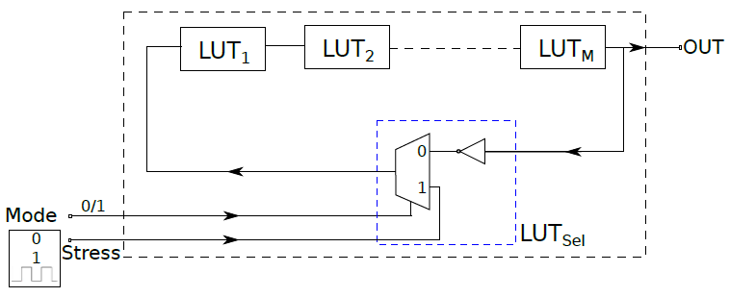
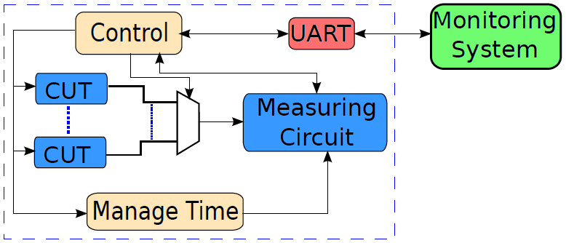
Test Set-Up
Several circuits under test connected by multiplexer to the measuring circuit
The test bench is communicate to the real time monitoring system.
56 CUTs, each one contains 9 LUTs configured as Buffer
Differences value of Duty cycle with low frequency stress signal
Notes:
We developed a low cost test bench which consist of a several circuit under test connected to measuring circuit in order to measure propagation time and duty cycle.
We also developed a control circuit to manage the time and the operation of the test bench. This test bench communicate with a real time monitoring system to acquire and process the data.
We implemented 56 CUTs, when each one consists of 9 LUT configured as buffer stressed by 7 different duty cycle under low frequency to eliminate the effect of hot carrier injection.

Slide 4
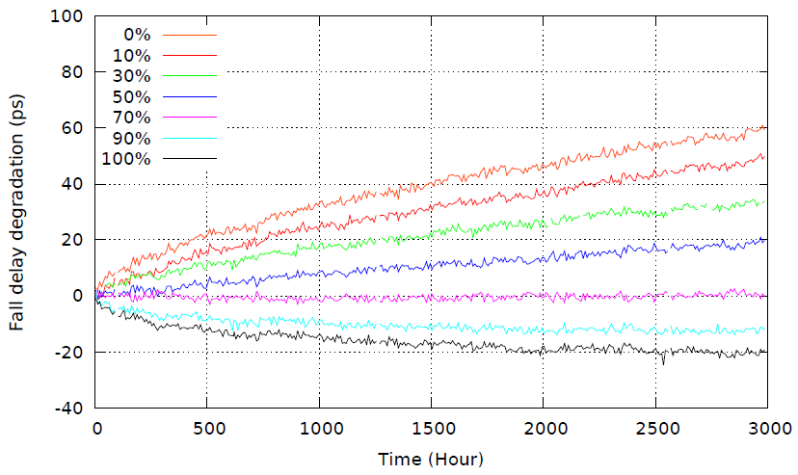
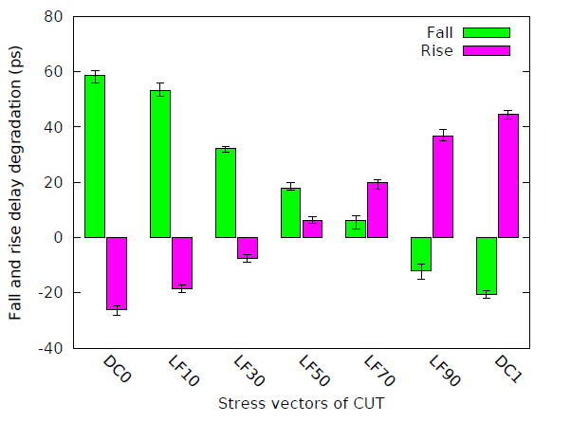
Experimental Results
Degraded when the duty cycle close to 0
Upgraded when close to 1
Opposite case for the rise delay
Duty cycle α
no hard failures of individual test cells
The degradation levels are very repeatable
No
TDDB
Notes:
The results during 3000 hours of accelerated aging test show that the fall delay degraded faster when duty cycle near to zero and upgraded while close to 1.
We did not see any hard failure of individual test cells and the results are very repeatable witch meaning no TDDB aging mechanism and no electromigration.
As mentioned before, we use low frequency stress and technology of 65 nm So the responsible aging mechanism is NBTI.

Slide 5
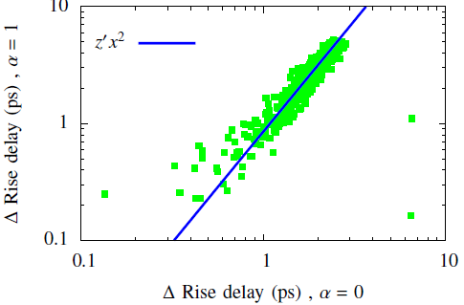
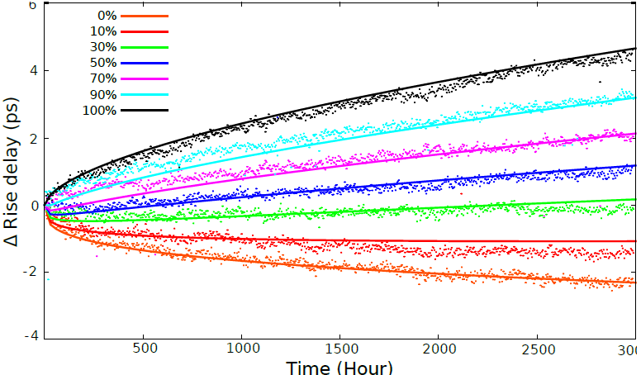
Modeling
Groups of transistors | Activate factor of transistor and duty cycle of stress signal
 | Fall Delay | Rise Delay
Stressed and measured | $$β=1 − α$$ | $$β=α$$
Relaxed and measured | $$β=α$$ | $$β=1−α$$
independent from the duty cycle | NC | NC
$${∆t}_{fall /rise}=h\left(αT,\left(1−α\right)T, T\right)$$
The fall delay degradation under DC0 stress is proportional to the square of the one under DC1 stress
${∆t}_{fall DC0}=z× {∆t}_{fall DC1}$
Notes:
After analyses the experimental results we divided the transistors of LUT into 3 groups : one related to the duty cycle of the stress signal
Other is complement to the first one and third not related to the stress signal.
In addition, the degradation of transistors of the group 1 (stressed and measured) is proportional to the square of that of group 2.
DC0 of fall delay is square to the DC1.
This is the globale expression of our semi-emperical model of delay degradation due to NBTI.
This model is based on power law with two different exponent.

Slide 6
Thank you !

