Slide 1
Optimizing Interconnection Complexity for
Realizing Fixed Permutation in Data and Signal Processing Algorithms
Ren Chen, Viktor K. Prasanna
Ming Hsieh Department of Electrical Engineering
Presented by:
Ajitesh Srivastava, Department of Computer Science
University of Southern California
Ganges.usc.edu/wiki/TAPAS

Slide 2
Outline
Introduction
Background and Related Work
High Throughput and Energy Efficient Design
Experimental Results
Conclusion and Future Work
Notes:
I’ve divided my talk into six parts.
First I’ll introduce the permutation on streaming data and problem definition.
Then I’ll discuss on the existed state-of-the-art solutions for permutation in hardware.
Later I’ll present our proposed novel mapping approach and the details of the algorithm.
Finally I’ll demonstrate our experimental results
and make conclusions on our work

Slide 3
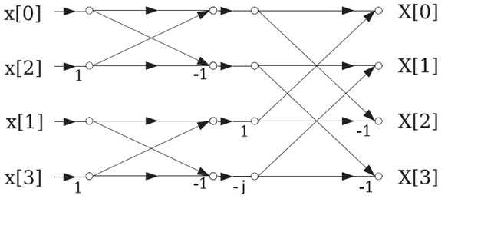
Permutation
Permutation
A permutation can be represented using
$$y=P_{m} ∙x$$
$m$ is the size of vectors $x$ and $y$
The $m×m$ bit matrix $P_{m}$ is called as a permutation matrix
Sorting network
FFT network
Notes:
A permutation can be presented using matrix, the permutation matrix denoted as Pm determines the permutation pattern.

Slide 4
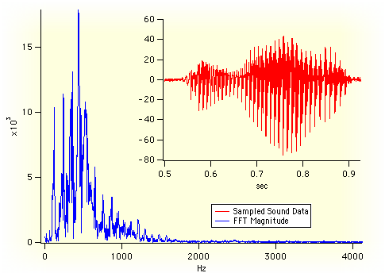
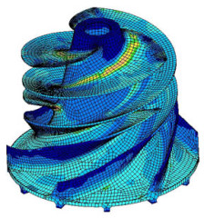
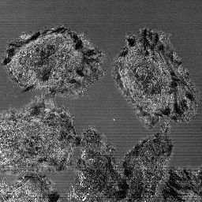
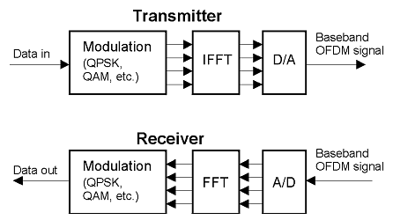
Related Applications
Key Algorithms: FFT, sorting, Viterbi decoding, etc.
Audio analysis
Frequency domain
in images
Partial differential equations
Bitonic sort
Image filtering
OFDM System
Notes:
Data permutations widely exist in data or signal processing algorithms, such as FFT, bitonic sorting, viterbi decoding, etc.
And these algorithms are kernels of various applications.

Slide 5
Data Permutation in Conventional Architectures
Permutation by wires
Parallel architecture
Permutation by memory
or registers
Pipeline architecture
Shared memory architecture
Notes:
Data permutations can be realized using memory, registers, or wires
parallel architecture shown in the figure b) uses wires to do data permutation.
Pipeline architecture and shared memory use memory or registers to do data permutation.
For example, the delay feedback or commutator in the hardware implementation of FFT

Slide 6
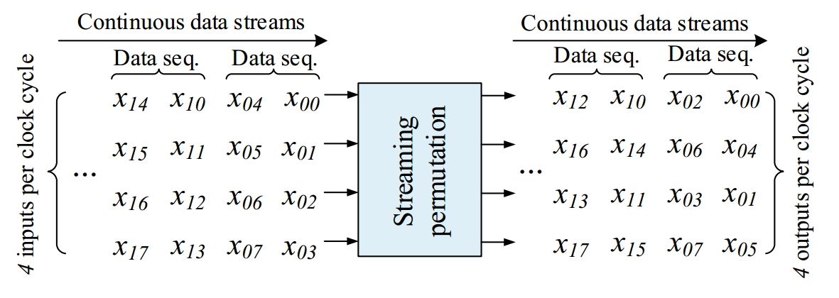
Data Permutation in Streaming Architectures
Streaming architecture
High data parallelism
High design throughput
Simple control scheme
No requirement on data input/ output order
Notes:
Streaming architectures are popular for hardware implementation of data or signal processing algorithms,
due to their higher data parallelism, higher throughput, and simple control scheme.
The key issue for implementing streaming architecture is how to realize permutation on streaming data.
The figure below shows how data sequences are permuted by streaming permutation:
Some data sequences are flowing into the stream permutation block, 4 inputs per clock cycles,
after a certain delay, the permuted data sequences flow out of the block, and also 4 outputs per clock cycle.
(Not required to explain)
With continuous input of data streams, the throughput of this design is 4 data results per clock cycles.
Assuming the data width per output is 32-bit, the clock period is 4 ns, then the throughput is 32 Gb/s.

Slide 7
Problem Definition
Permute streaming data with a fixed data parallelism
Input/output: in a streaming manner and at a fixed rate
Data parallelism $p$: # of inputs processed each cycle per computation stage
Streaming permutation: permutation between adjacent computation stages
Processing elements: computation units for a given application
Notes:
In summary, the problem to be solved in this paper is to permute streaming data with a fixed data parallelism.
We have streaming data input and output.
Each cycle p data inputs and outputs.
Data permutations are performed between adjacent computation stages.
Fig. shows the architectural framework within which we propose our data permutation approach using FPGA as the target platform.

Slide 8
Outline
Introduction
Background and Related Work
High Throughput and Energy Efficient Design
Experimental Results
Conclusion and Future Work

Slide 9
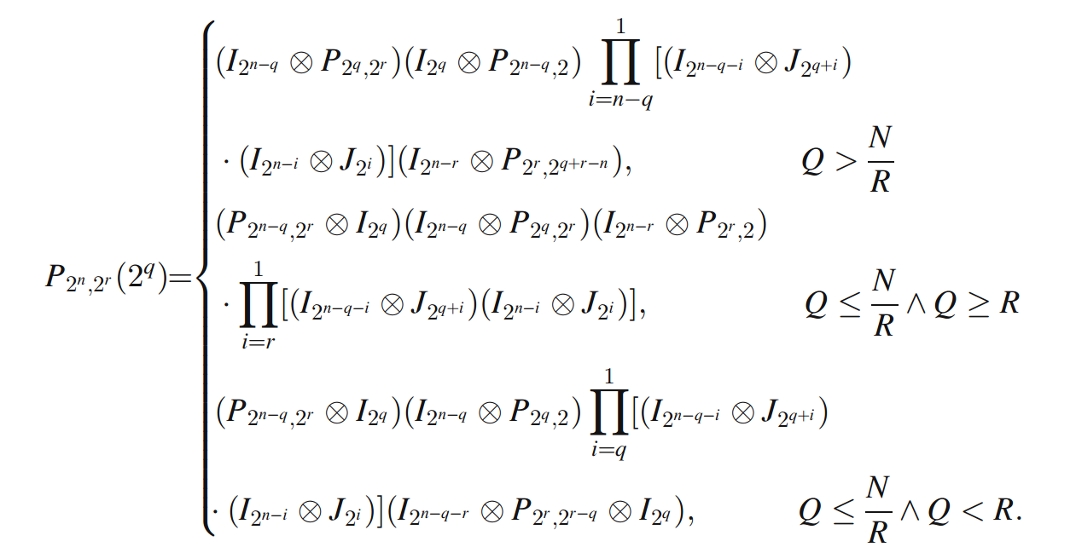
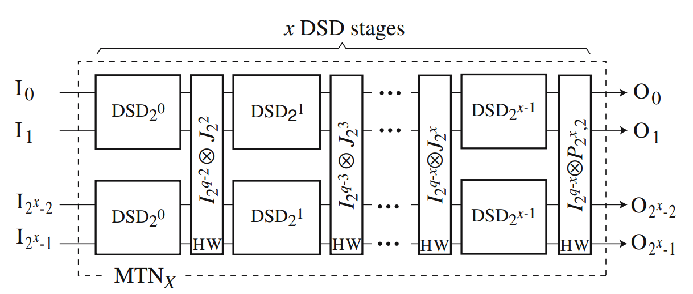
Related Work (JVSP ’07, T. JARVINEN)
For stride permutation on
array processor
Flexible data parallelism
Mathematical formulation
Notes:
There have been work proposed to realize permutation on streaming data, however mostly focused on specific permutation patterns, such as stride permutation in FFT.
In this related work, the author developed a streaming architecture for realizing stride permutation on array processor.

Slide 10
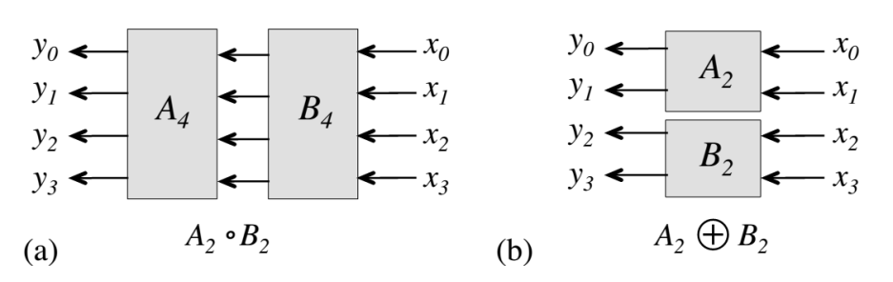
Related Work (DAC ’12, M. Zuluaga and M. Püschel)
Domain-specific language based
Hardware generator for data permutations in sorting
Notes:
In [28], the SPIRAL project develop
DSL (Domain Specific Language) to enable mapping sorting algorithms with
flexible design choices.
They developed a design automation tool to generate datapath for streaming permutation,
However their approach is expensive in both memory and control logic.

Slide 11
Proposed Design Approach
Drawbacks of the state-of-the-art
Only supports specific permutation patterns
Design scalability needs to be improved
Interconnection complexity is not considered
We propose a mapping approach to obtain a streaming permutation architecture
Utilizes Benes network for building datapath and generating control logic
Highly optimized wrt. memory efficiency and interconnection complexity
Scalable with problem size $N$ and data parallelism $p$
Supports processing continuous data streams
Design automation tool
Notes:
For the existed state-of-the-art designs, some of them only supports specific permutation patterns,
Some of them are not memory or resource efficient.
In our work, we propose a novel mapping approach to obtain a streaming permutation architecture,
By utilizing Benes network to build the datapath and generating control logic
Our design proves to be highly optimized with regards to memory efficiency and interconnection complexity,
And highly scalable with problem size and data parallelism.
We also developed a design automation tool

Slide 12
Outline
Introduction
Background and Related Work
High Throughput and Energy Efficient Design
Experimental Results
Conclusion and Future Work
Notes:
Let’s continue to our proposed design approach

Slide 13
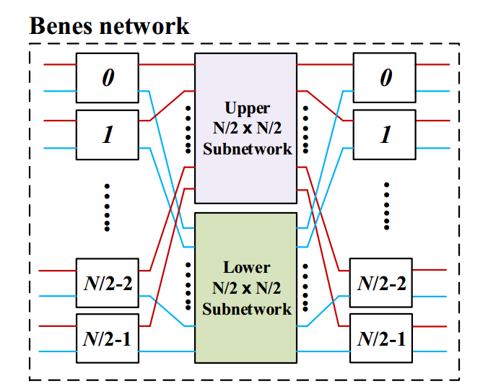
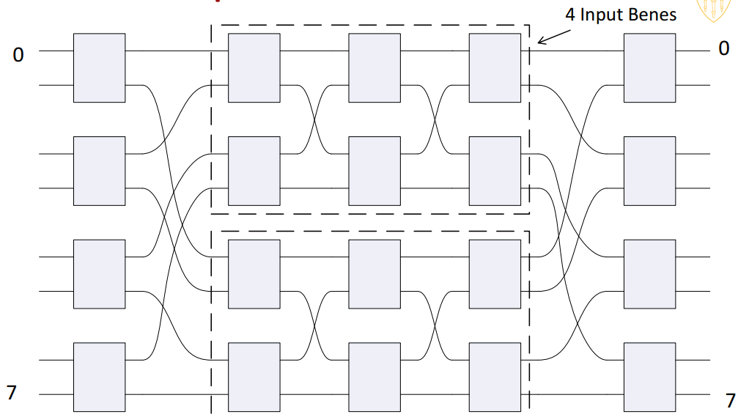
Benes Network
Multistage network to realize all $n!$ permutations
Rearrangeably non-blocking
Notes:
I’d like to talk about Benes network before introducing our design approach.
Assuming n inputs and n outputs, Bene network is a multistage network to realize all n! permutations.
Rearrangeably non-blocking means that, we can always find a way to realize any fixed permutation by configuring the switches in the Benes network.
The figure on the right shows the 8-input Benes network

Slide 14
Architecture Overview
Parameterized architecture
Problem size $N$
Data parallelism $p$
Memory based
$p$ independent memory blocks
Each of size $N/p$
$p$-to-$p$ connection network
$\left(\frac{p}{2}\right)\log{p} 2×2$switches
Optimal compared with state
-of-the art
Highly optimized control unit
Notes:
Fig. on the right shows the overall architecture of the streaming design.
Design parameters include problem size N and data parallelism p.
The datapath consists of two p-to-p connection networks, one memory array including p independent memory blocks, each of size N=p.
The control unit has two configuration tables to reconfigure the connection networks dynamically, and one address generation unit (AGU) for memory access.
Each connection network has log p stages of 2x2 switches. Each stage has p=2 switches. Thus, a connection network utilizes (p=2) log p 2x2 switches,
which is asymptotically optimal compared with state-of-the-art [1, 8, 6].
(No need to explain only if asked:)
We consider using two different memory architectures: each memory has one read port and one write port, or each memory has a concurrent read-before-write port
(two data ports sharing one address port).

Slide 15
Generating the Datapath (1)
Generating Datapath
$N$: input size
$p$: data parallelism
$l$, $r$: 2x2 switch
$mi$ : subnetwork of size $n/p$
$LB$, $RB$: $p$-input block
$L$ , $R$ : 2x2 switch
$Wi/W’i$ : $p$-to-$p$ wire connection
Notes:
The right figure shows the key idea of generating the datapath of our design uisng Benes network
We propose a divide-and-conquer based mapping approach.
As shown in the right figure, the Benes network has been decomposed into p subnetworks with log p stages of 2x2 switches on the left or right.
Correspondingly, p memory blocks in our proposed streaming permutation network are employed to realize the permutation of the p subnetworks temporally.
The SPN also has logp/2 stages of 2x2 switches on the left and right.
Explain the meaning of the notations if needed.

Slide 16
Generating the Datapath (2)
For a fixed data parallelism $p$, the streaming permutation network is able to realize arbitrary permutation
In $LB$, $Wi$ = $I_{2^{i}}⊗$ $P_{p/2^{i},2}$
Permutation in $mi$ is performed by $Mi$ temporally
In $RB$, $W′i$ = $I_{2^{i}}⊗$ $P_{p/2^{i},p/2^{i+1}}$
Number of $2×2$ switches: $p\log{p}$
Maximum wire length: $O(p)$
Notes:
We theoretically prove that for a fixed data parallelism $p$, the streaming permutation network is able to realize arbitrary permutation with the listed three assumptions.
And based on our data path generation algorithm, the total number of 2x2 switches is plogp,
The maximum wire length is o(p), the number of n/p-entry memory is p.

Slide 17
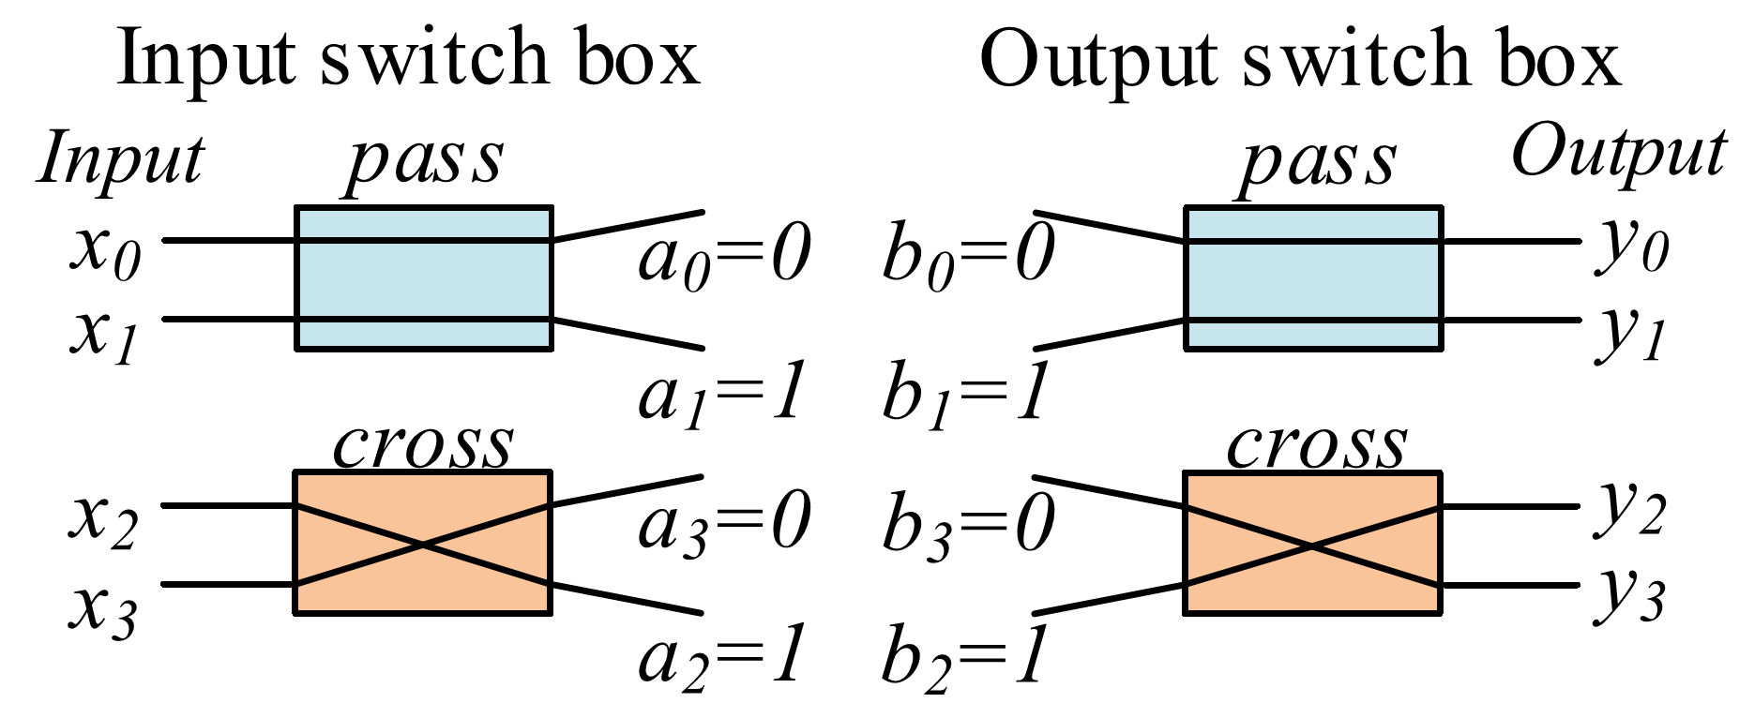
Optimization of Interconnection Complexity (1)
Configuration bits of switch in different states
$x:$ input of Benes network, $y:$ output of Benes network
$a\left(i\right):$ configuration bits for $x(i)$, $b(i)$: configuration bit for $y (i)$
Two states for a $2×2$ switch: pass or cross
Notes:
Let’s continue with our algorithm for generating the control logic.
The key idea is to configure the Benes network for a given fixed permutation. The resulting configuration bits are then taken as input to generate the configuration
tables and the AGU shown in the figure in slides 14.
A 2 x 2 switch of a Benes network will be either in pass state or cross state, which can be represented by a Boolean variable.
As shown in the figure, let X and Y be the set of inputs and outputs of a Benes network respectively,
let a : X -> {0, 1} and b : Y -> {0, 1}, where a(i) is the configuration bit of X(i), and b(i) is the configuration bit of Y (i).
(No need to explain only if needed)
Explain:
For input switch
a0=0, means input 0 will be routed to the upper side, a1=1, means input 1 will be routed to the lower side.
a3=0, means input 3 will be routed to the upper side, a2=1, means input 2 will be routed to the lower side.
similarly for output switch

Slide 18
Optimization of Interconnection Complexity (2)
Key Idea
A null switch can be replaced by wires
A null switch: always in either pass or cross state
Notes:
We define a null switch as a switch which is always in either pass or cross state.
The key idea to optimize the interconnection complexity is to replace the null switches with wires.
As shown in the right figures, the null switches in the top right figure are replaced with wires in the bottom right figure, as these switches are constantly in either pass or cross state.

Slide 19
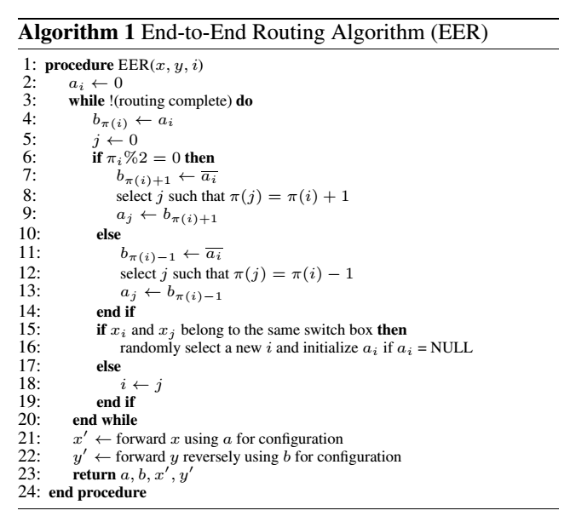
Optimization of Interconnection Complexity (3)
End-to-End Routing
Called for computing
configuration bits
$x$: input data vector
$y$: permuted data vector
$π$: mapping from $X$ to $Y$
$x′$: output data vector of
input switches
y$′$: input data vector of
output switches
Notes:
The EER procedure returns four vectors including a, b, x’, y’
a and b are the configuration bits for data vector x and y,
After a and b are determined, x is the input of input switches, and x’ is the resulting data vector;
y is the output of output switches, and y’ is the input of the output switches.
Each time when calling EER (end-to-end routing), the algorithm will search for solutions to configure the input and output switch,
i.e., to determine the value of a and b.
After the values of a and b are determined, the x will be routed by the input switch to obtain x’, and the y will be routed by the output switch to obtain y’
As limited by time, I will bypass the details of our EER algorithm, for more details please refer our paper.

Slide 20
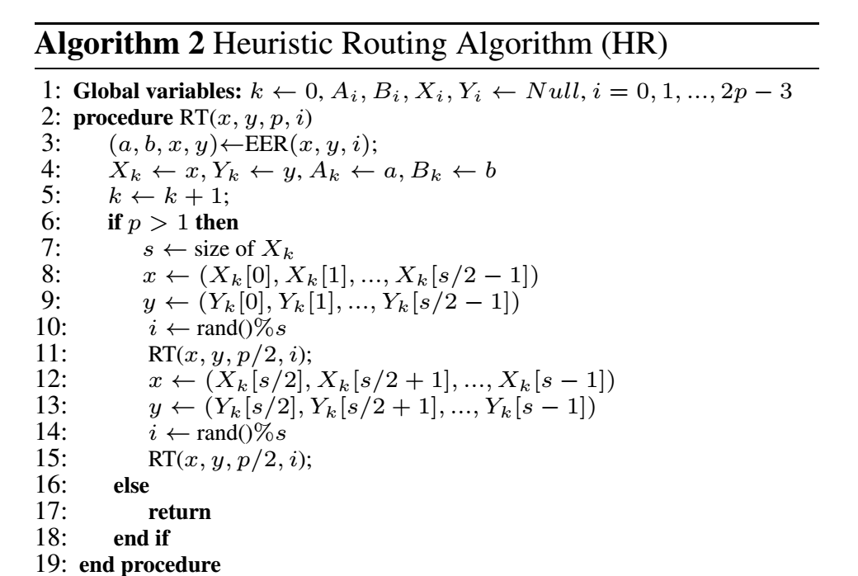
Optimization of Interconnection Complexity (4)
Heuristic Routing Algorithm:
RT procedure
Compute the configuration
bits of $LB$and $RB$in $\log{p}$ steps
Results vary in different runs
Iteratively called many times
Notes:
We propose a heuristic routing algorithm to maximize the number of null switches in the proposed streaming permutation network
The algorithm will call RT procedure several times to compute the configuration bits of LB and RB in log p steps.
As shown in the right figure, RT takes as inputs parameters including x, y, and p.
When p > 1,
RT() will be called to route the upper subnetwork and the lower subnetwork.
Otherwise,
ai, bi, Xi and Yi obtained by EER will be returned.
As limited by time, I will bypass the details of our RT algorithm, for more details please refer our paper.

Slide 21
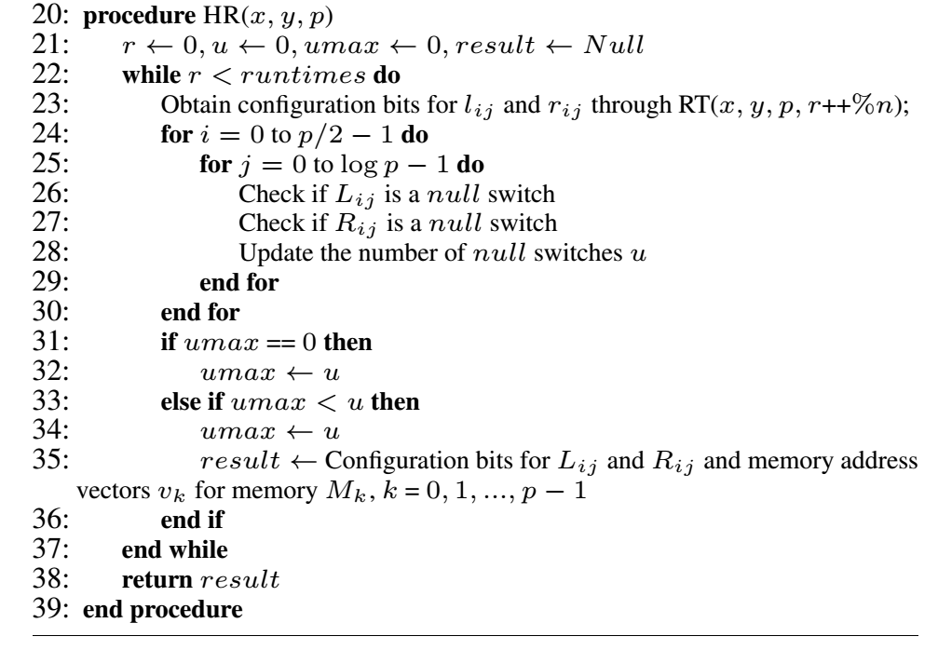
Optimization of Interconnection Complexity (5)
Heuristic Routing Algorithm
Call RT procedure to compute
configuration bits
Search for the solution having
maximum number of null switches
Notes:
By iteratively call the RT procedure, our proposed heuristic routing algorithm will search for the solution having the maximum number of null switches.
The algorithm will be run statically with a time complexity of O(n²log p) to generate the datapath of the proposed streaming permutation network.

Slide 22
Resource Consumption Summary
Designs in [1] and [8]
Only support specific family of permutation
Our design consumes same amount of resource in the worst case
Design in [9]
Our design uses half amount of memory
Both consume $O(p\log{p)}$ logic for mux
Notes:
Please just summarize as the texts in the slides

Slide 23
Outline
Introduction
Background and Related Work
High Throughput and Energy Efficient Design
Experimental Results
Conclusion and Future Work

Slide 24
Performance metrics
Throughput
Defined as the number of bits permuted per second (Gbits/s)
Product of number of data elements permuted per second and data width per element
Energy efficiency
Defined as the number of bits permuted per unit energy consumption (Gbits/Joule)
Calculated as the throughput divided by the average power consumption

Slide 25
Experimental Setup
Platform and tools
Xilinx Virtex-7 XC7VX980T , speed grade -2L
Xilinx Vivado 2015.2 and Vivado Power Analyzer
Input vectors for simulation randomly generated
Performance metrics
Resource consumption
Throughput
Energy efficiency
Notes:
Just repeat the content in this slides
Note to say:
As the cost of our design datapath does not depend on the specific
permutation to be performed, we choose one randomly for
various N and p in experiments. The same permutations are
also chosen for our baselines.

Slide 26
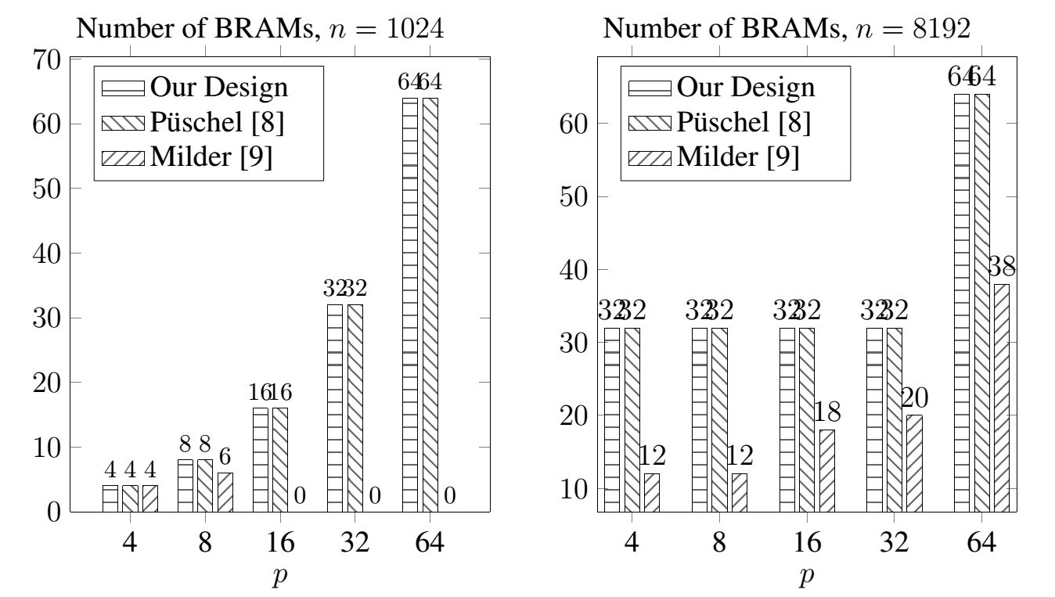
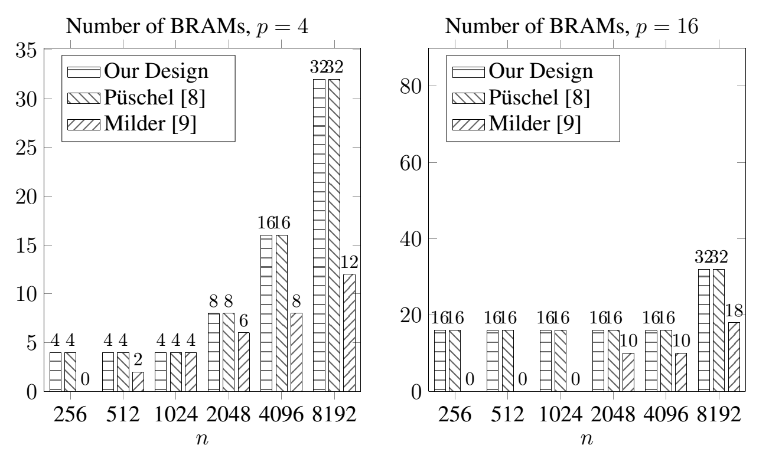
Experimental Results (1)
BRAM consumption of the proposed design
[9] uses BRAM-LUT mostly for realizing the 2p memory blocks
Our design consumes the same amount of BRAMs (O(p)) compared with [8]
Note designs in [8] only realize bit index permutations
Notes:
Each BRAM18 has 18kb, if the memory requirement is < 18kb, then a BRAM18 will be used.
If the memory requirement is between 18 kb and 36 kb, then two BRAM18 will be used.
In the left figure,
our design and design in [8] need p memory blocks, each of size N/p (ours), and 2N/p ([1]) .
When p changes, N/p and 2N/p are always < 18kb, so the number of BRAMs are the same.
Design in [9] needs 2p memory blocks, each of size 2N/p, however, it only uses distributed RAM to replace BRAM for different memory size.
In the right figure, when p > 32, our design and design in [8] consume the same amount of BRAMs. (Similar explanation can be explained)

Slide 27
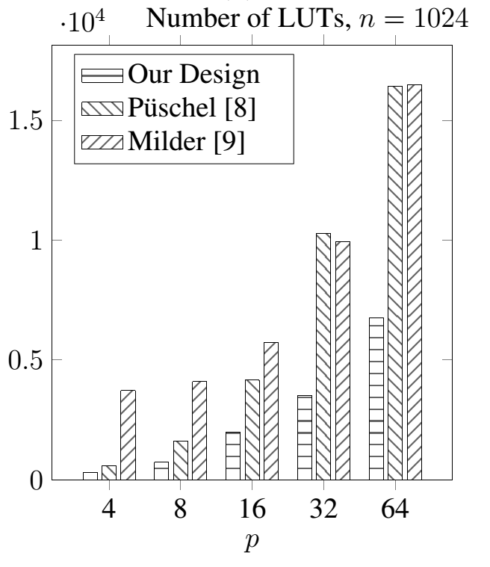
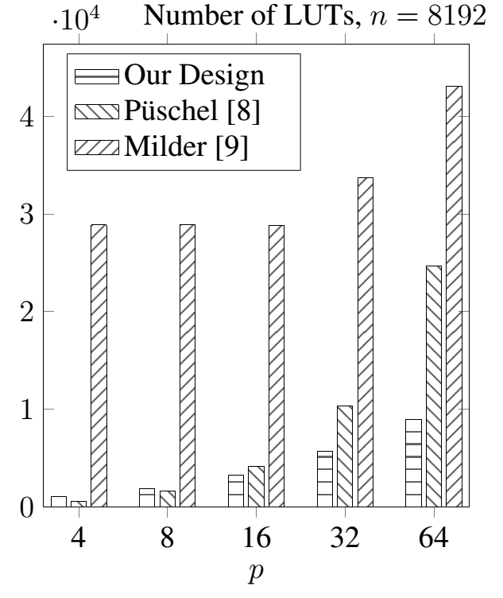
Experimental Results (2)
LUT consumption of the proposed design (for various $p$)
22.1%~65.7% less LUTs compared with [8]
59.1%~96.4% less LUTs compared with [9]
Notes:
This slides show the LUT consumption of our design and the baselines
Compared to the design in [8], our design reduces the LUT consumption by 22.1%~65.7% benefiting from our mapping approach.
As the design in [9] uses distributed RAM for memory implementation, our design uses 59.1%~96.4% less LUTs compared with [9]

Slide 28
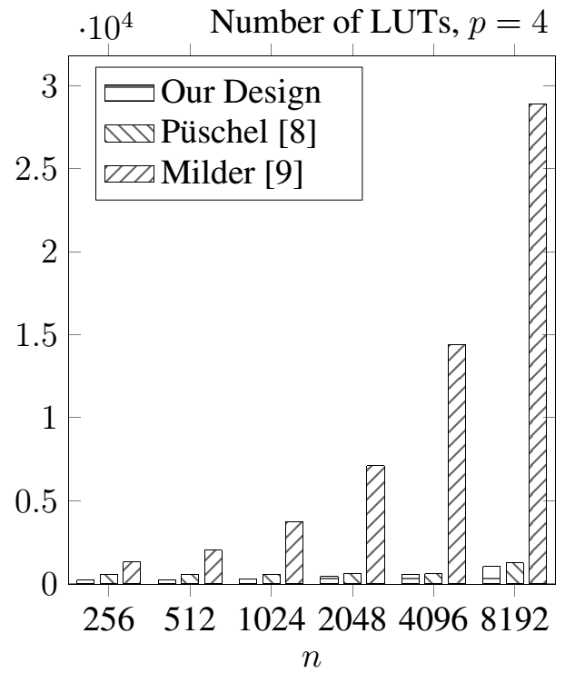
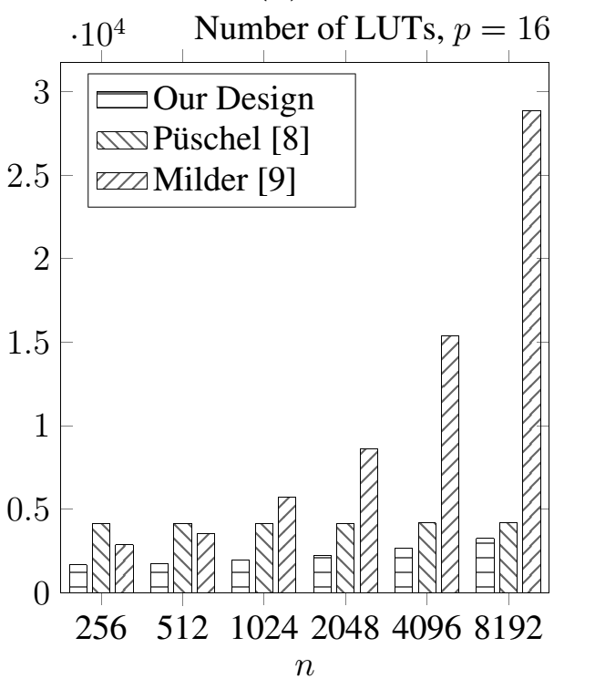
Experimental Results (3)
LUT consumption of the proposed design (for various $n$)
27.3%~75.8% less LUTs compared with [8]
42.2%~92.3% less LUTs compared with [9]
Notes:
This slides show the LUT consumption of our design and the baselines for various N
Compared to the design in [8], our design reduces the LUT consumption by 27.3%~75.8% benefiting from our mapping approach.
As the design in [9] uses distributed RAM for memory implementation, our design uses 42.2%~92.3% less LUTs compared with [9]

Slide 29
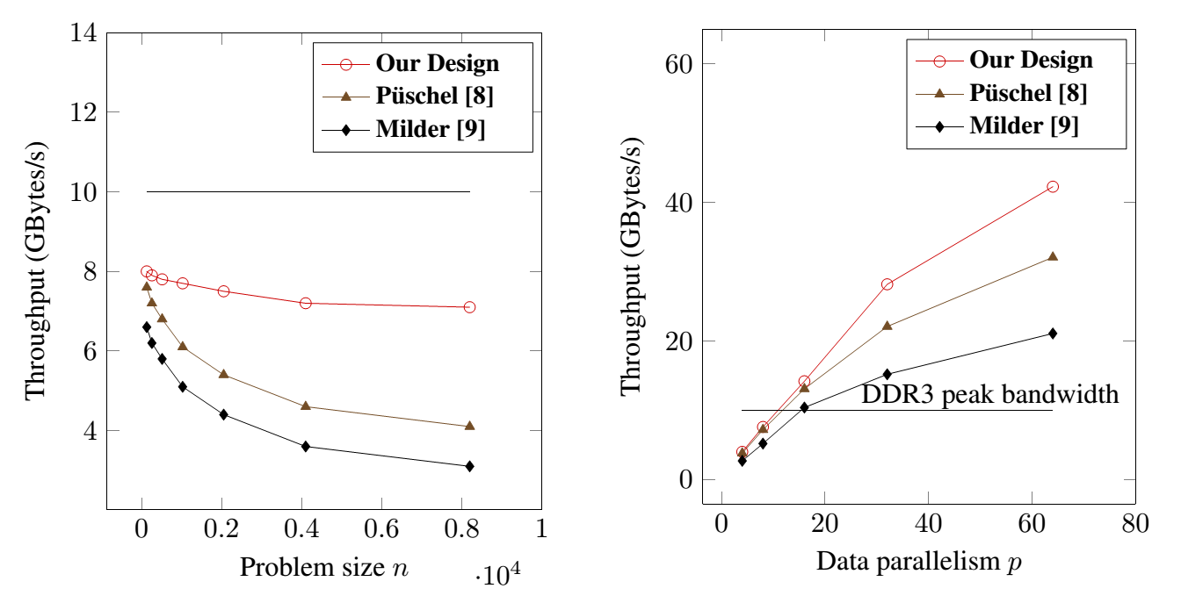
Experimental Results (5)
Throughput performance of the proposed design
Our designs achieve
Up to 73.2% throughput improvement compared with [8]
Up to 129% throughput improvement compare with [9]
Notes:
We assume the design throughput is only determined by the data parallelism and the maximum operating frequency reported by the post place-and-route results.
The left Fig. demonstrates the design throughput for various N with p = 4.
As the problem size increases, the throughput decreases due to the lower achievable maximum operating frequency by the design.
As shown in the figure, our design is able to sustain 71%~80% of the DDR3 peak bandwidth, (approximately 10 GBytes/s [13]) for various N with p = 4.
We employed a balanced pipelining approach for the purpose of trade off between energy efficiency and throughput.
Left Fig. shows that compared with the baselines, the throughput is improved significantly (up to 73.2%) in our design, especially for large problem sizes. Such performance
improvement can be expected considering that less BRAM blocks and LUTs are used in our design.
Right fig. demonstrates the design throughput for various p with N = 8192.
This Fig. also shows that the DDR3 peak bandwidth can be easily saturated when p > 16. In such cases, we can only employ the on-chip BRAMs with
extremely high bandwidth as the data memory. This also implies that a potential high memory bandwidth utilization may be achieved if using the emerging 3D stacked memory providing up to 16x more throughput than DDR3 [13].

Slide 30
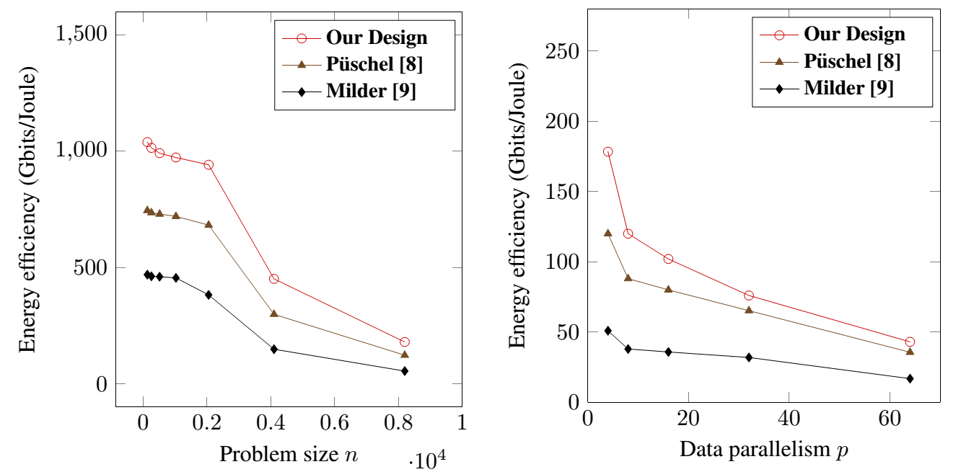
Experimental Results (6)
Energy efficiency comparison
2.1x~3.5x energy efficiency improvement compared with the state-of-the-art in [9]
1.2x~1.5x energy efficiency improvement compared with the state-of-the-art in [8]
Notes:
We also evaluate the energy efficiency of our design. We only focus on the dynamic power consumption of our proposed permutation
design and the baselines. The left figure demonstrates the energy efficiency for various N from 128 to 8192
with p = 4. It can be observed that the energy efficiency drops significantly when N = 2048. This is due to the
fact that the number of BRAMs used starts to increase with N when N > 2048. The result also shows that as the
problem size is varied, our design achieves 2.1x~3.5x improvement in energy efficiency compared with design in [8].
The right figure demonstrates the energy efficiency when varying p
with N = 8192. As noted in figure in slides 31, the LUT consumption dramatically increases with p,
the energy efficiency decreases significantly accordingly. As shown in the right figure, for
various p, our design improves energy efficiency by up to 3.5x compared with the baselines

Slide 31
Conclusion and Future Work
Conclusion
Streaming data permutation architecture
Scalable with data parallelism and problem size
Efficient data permutation realization
Highly optimized with interconnection complexity
High throughput and resource efficient
Future work
Automatic generation of high throughput resource efficient signal and data processing kernels
31

Slide 32
Thanks!
Questions?
Ganges.usc.edu/wiki/TAPAS
32

