Slide 1

DT-CGRA: Dual-Track Coarse-Grained Reconfigurable Architecture for Stream Applications
Xitian Fan, Huimin Li, Wei Cao, Lingli Wang
Fudan University

Slide 2

Outline
The dual-track programming model
The dual-track CGRA architecture
Computing pattern examples
Experiments
Summary

Slide 3
Outline
The dual-track programming model
The dual-track CGRA architecture
Computing pattern examples
Experiments
Summary

Slide 4
























The Dual-Track Programming Model (1)
Observations from object detection/classification domain:
Deep learning : CNN
convolution
fully connected
pooling
$$w_{1}$$
$$w_{1}$$
$$w_{2}$$
$$w_{2}$$
$$w_{3}$$
$$w_{3}$$
1/9
$$w_{4}$$
$$w_{4}$$
…
1/9
1/9
$$w_{5}$$
$$w_{5}$$
1/9
1/9
1/9
$$w_{6}$$
$$w_{6}$$
$$w_{11}$$
$$w_{12}$$
$$w_{1n}$$
duplicate of input data
$$w_{7}$$
$$w_{7}$$
$$w_{8}$$
1/9
$$w_{8}$$
$$w_{9}$$
$$w_{9}$$
1/9
1/9
1/9
1/9
1/9
…
1/9
$$w_{21}$$
$$w_{22}$$
$$w_{2n}$$
1/9
1/9
1/9
1/9
1/9
…
…
…

Slide 5
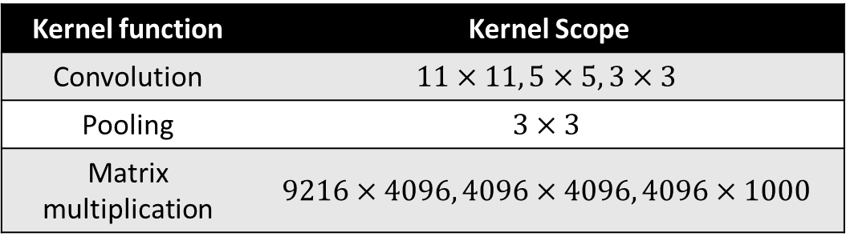
The Dual-Track Programming Model (1)
Observations from object detection/classification domain:
Deep learning : CNN
Kernel function | Kernel Scope
Convolution | $$11×11, 5×5, 3×3$$
Pooling | $$3×3$$
Matrix multiplication | $$9216×4096, 4096×4096, 4096×1000$$
Computing abstraction:
A kernel function do computation over a limited kernel scope.
The kernel scope shifts in a specific order with a stride.

Slide 6
The Dual-Track Programming Model (2)
What is the dual-track programming model ?
Need reconfiguration when kernel function is changed
Dynamic configuration
Pseudo-static configuration
load
DMAs
Computing Components
store
From the hardware perspective:
Computing components are configured only once.
Data managers are required to control data streams.
The kernel functionality remains unchanged.
The data in the kernel scope have changed.

Slide 7
The Dual-Track Programming Model (3)
What is the dual-track programming model ?
Determine the functionality of computing components
dynamic configuration
pseudo-static configuration
Determine the behavior of DMAs
load
DMAs
Computing Components
store
dual-track

Slide 8
Outline
The dual-track programming model
The dual-track CGRA architecture
Computing pattern examples
Experiments
Summary

Slide 9
The Dual-Track CGRA (1)
Dynamic configuration
Pseudo-static configuration
Interconnection between multi-channel data bus and RCs
Interconnection among RCs
load
DMAs
Computing Components
store
Off-chip memory DMA interface
CA | Computing Array
SBU | Stream Buffer Unit
RC | Reconfigurable Cell
PRC | Reconfigurable Cell to calculate Power function
IRC | Reconfigurable Cell to calculate Interpolation
Interface with other node
Dynamic configuration interface
Pseudo-static configuration interface

Slide 10


The Dual-Track CGRA (2)
RC unit
FIFO
SRAM
FIFO
SRAM
FIFO
SRAM
Simplify the control flow.
Reduce the bandwidth of the output interface.
Support configuration, decomposition and combination.
“map” part
FIFO
SRAM
Multiplier | 16 bit
ALU | 16 bit
$$16bit×64, 128 Byte$$
“reduce” part
$$16bit ×256, 512 Byte$$
FIFO
FIFO
Ctr Unit

Slide 11
The Dual-Track CGRA (3)
RC unit
Computing pattern examples:
FIFO
SRAM
FIFO
SRAM
FIFO
SRAM
1
“map” part
“reduce” part
FIFO
FIFO
Ctr Unit

Slide 12
The Dual-Track CGRA (4)
RC unit
Computing pattern examples:
FIFO
SRAM
FIFO
SRAM
FIFO
SRAM
2
“map” part
“reduce” part
FIFO
FIFO
Ctr Unit

Slide 13
The Dual-Track CGRA (5)
RC unit
Suppose: a kernel requires 5 multiplier-adders

Slide 14
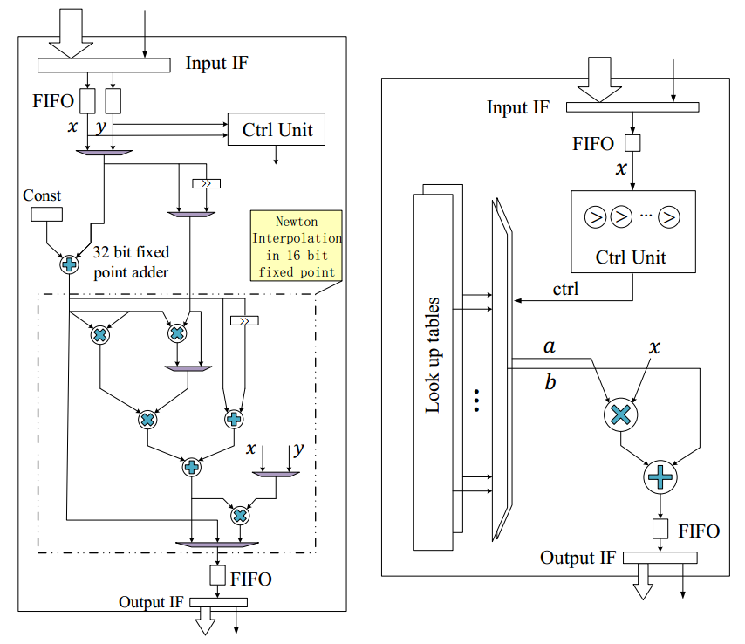
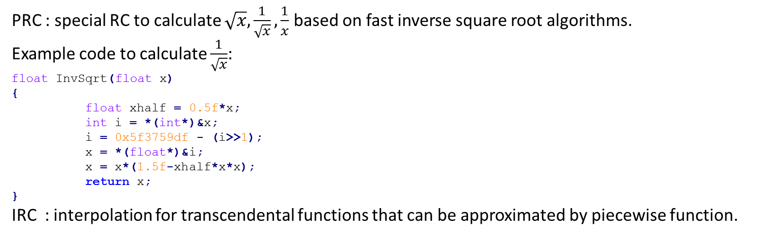
The Dual-Track CGRA (6)
PRC & IRC unit
PRC : special RC to calculate $\sqrt{x},\frac{1}{\sqrt{x}},\frac{1}{x}$ based on fast inverse square root algorithms.
Example code to calculate $\frac{1}{\sqrt{x}}$:
float InvSqrt(float x)
{
float xhalf = 0.5f*x;
int i = *(int*)&x;
i = 0x5f3759df - (i>>1);
x = *(float*)&i;
x = x*(1.5f-xhalf*x*x);
return x;
}
IRC : interpolation for transcendental functions that can be approximated by piecewise function.
(a) PRC
(b) IRC

Slide 15
The Dual-Track CGRA (7)
Interconnections among RCs:
horizontal interconnections
valid
valid
RC
RC
…
RC
RC
stop
stop
RC
RC
…
RC
RC
…
Elastic data transmission
Simplify the control behavior

Slide 16
The Dual-Track CGRA (8)
Interconnections among RCs:
vertical interconnections
RC
…
RC
data
sel
valid
Multi-Channel data bus
stop
…
Input interface
Output interface
RC
…
RC
To next row of RC

Slide 17
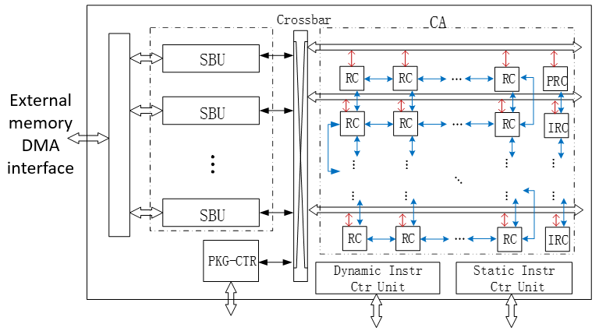

The Dual-Track CGRA (9)
execution time
Stream Buffer Unit: SBU
configure
execution
execution
configure
configure
idle state of configuration
Double buffer technique to reduce configuration overhead
ExternalBus
WrBus
Stream Register File
DMA
Controlled dynamically by VLIW
$$16 bit×1024$$
RdBus

Slide 18
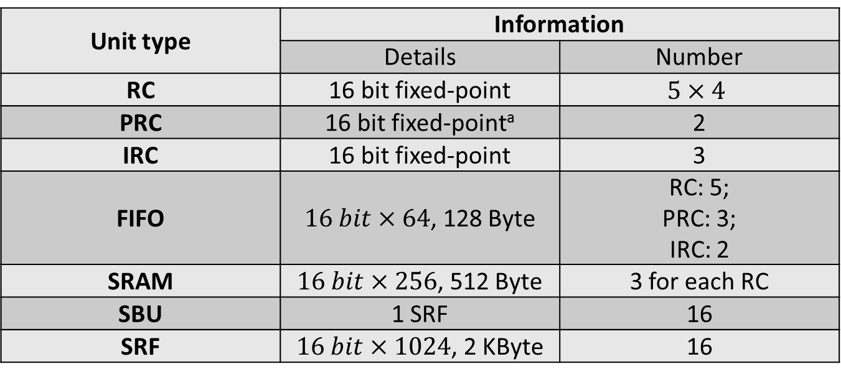
The Dual-Track CGRA (10)
Detail information of each unit in DT-CGRA
Unit type | Information
 | Details | Number
RC | 16 bit fixed-point | $$5×4$$
PRC | 16 bit fixed-pointª | 2
IRC | 16 bit fixed-point | 3
FIFO | $16 bit×64$, 128 Byte | RC: 5; PRC: 3; IRC: 2
SRAM | $16 bit×256$, 512 Byte | 3 for each RC
SBU | 1 SRF | 16
SRF | $16 bit×1024$, 2 KByte | 16

Slide 19
Outline
The dual-track programming model
The dual-track CGRA architecture
Computing pattern examples
Experiments
Summary

Slide 20



Computing Pattern Examples (1)
Convolution in CNN:
one of the computing strategies
Kernel size: $5×5$; stride: 2.
…
…
…
…
Final convolution results
…
$$⊗$$
…
#Phase 0
convolution with the first row of R, G, B part of the kernel
#Phase 1
convolution with the second row of R, G, B part of the kernel
…
…
…
$$⊗$$
…

Slide 21
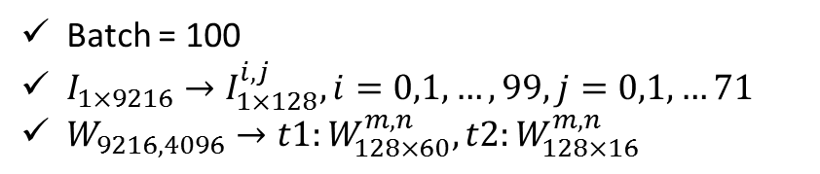
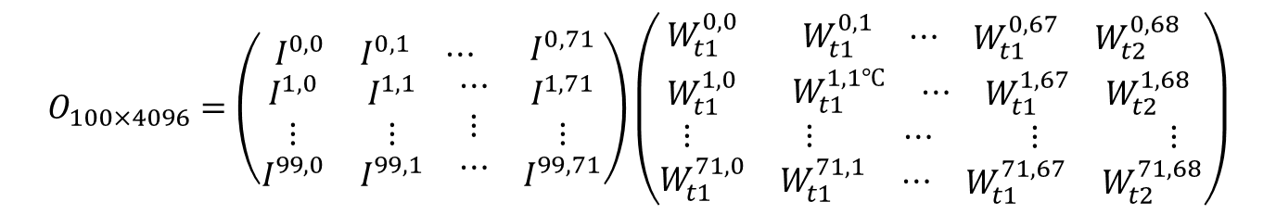

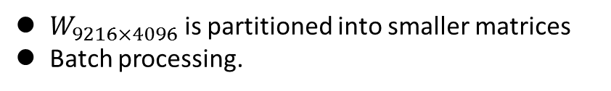

Computing Pattern Examples (3)
Matrix multiplication: Fully connected Layer in CNN
FC6 in AlexNet:
$$O_{1×4096}=I_{1×9216}∙W_{9216×4096}$$
$W_{9216×4096}$ is partitioned into smaller matrices
Batch processing.
Batch = 100
$I_{1×9216}→I_{1×128}^{i,j}, i=0,1,…,99,j=0,1,…71$
$W_{9216,4096}→t1:W_{128×60}^{m,n}, t2:W_{128×16}^{m,n}$
$$O_{1×4096}=I_{1×9216}∙W_{9216×4096}$$
$$O_{100×4096}=\left(\begin{matrix}\begin{matrix}I^{0,0} & I^{0,1} & ⋯\end{matrix} & I^{0,71} \\ \begin{matrix}\begin{matrix}I^{1,0} \\ ⋮ \\ I^{99,0}\end{matrix} & \begin{matrix}I^{1,1} \\ ⋮ \\ I^{99,1}\end{matrix} & \begin{matrix}⋯ \\ ⋮ \\ ⋯\end{matrix}\end{matrix} & \begin{matrix}I^{1,71} \\ ⋮ \\ I^{99,71}\end{matrix}\end{matrix}\right)\left(\begin{matrix}W_{t1}^{0,0} & \begin{matrix}W_{t1}^{0,1} & ⋯ & \begin{matrix}W_{t1}^{0,67} & W_{t2}^{0,68}\end{matrix}\end{matrix} \\ \begin{matrix}W_{t1}^{1,0} \\ ⋮ \\ W_{t1}^{71,0}\end{matrix} & \begin{matrix}\begin{matrix}W_{t1}^{1,1℃} & ⋯ & \begin{matrix}W_{t1}^{1,67} & W_{t2}^{1,68}\end{matrix}\end{matrix} \\ \begin{matrix}⋮ & ⋯ & \begin{matrix} ⋮ & ⋮\end{matrix}\end{matrix} \\ \begin{matrix}W_{t1}^{71,1} & ⋯ & \begin{matrix}W_{t1}^{71,67} & W_{t2}^{71,68}\end{matrix}\end{matrix}\end{matrix}\end{matrix}\right)$$

Slide 22
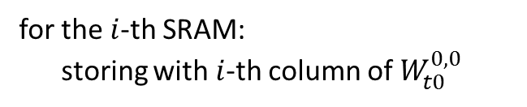

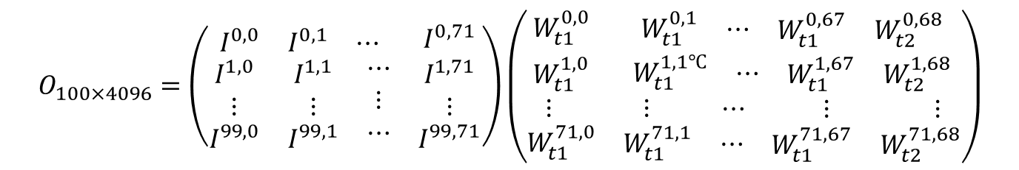
Computing Pattern Examples (4)
Matrix multiplication: Fully connected Layer in CNN
$$O_{100×4096}=\left(\begin{matrix}\begin{matrix}I^{0,0} & I^{0,1} & ⋯\end{matrix} & I^{0,71} \\ \begin{matrix}\begin{matrix}I^{1,0} \\ ⋮ \\ I^{99,0}\end{matrix} & \begin{matrix}I^{1,1} \\ ⋮ \\ I^{99,1}\end{matrix} & \begin{matrix}⋯ \\ ⋮ \\ ⋯\end{matrix}\end{matrix} & \begin{matrix}I^{1,71} \\ ⋮ \\ I^{99,71}\end{matrix}\end{matrix}\right)\left(\begin{matrix}W_{t1}^{0,0} & \begin{matrix}W_{t1}^{0,1} & ⋯ & \begin{matrix}W_{t1}^{0,67} & W_{t2}^{0,68}\end{matrix}\end{matrix} \\ \begin{matrix}W_{t1}^{1,0} \\ ⋮ \\ W_{t1}^{71,0}\end{matrix} & \begin{matrix}\begin{matrix}W_{t1}^{1,1℃} & ⋯ & \begin{matrix}W_{t1}^{1,67} & W_{t2}^{1,68}\end{matrix}\end{matrix} \\ \begin{matrix}⋮ & ⋯ & \begin{matrix} ⋮ & ⋮\end{matrix}\end{matrix} \\ \begin{matrix}W_{t1}^{71,1} & ⋯ & \begin{matrix}W_{t1}^{71,67} & W_{t2}^{71,68}\end{matrix}\end{matrix}\end{matrix}\end{matrix}\right)$$
$${W_{t0}^{0,0}=W}_{128×60}$$
for the $i$-th SRAM:
storing with $i$-th column of $W_{t0}^{0,0}$
SRAMs adopt double buffer technique to reduce the overhead of loading weights.

Slide 23
Outline
The dual-track programming model
The dual-track CGRA architecture
Computing pattern examples
Experiments
Summary

Slide 24
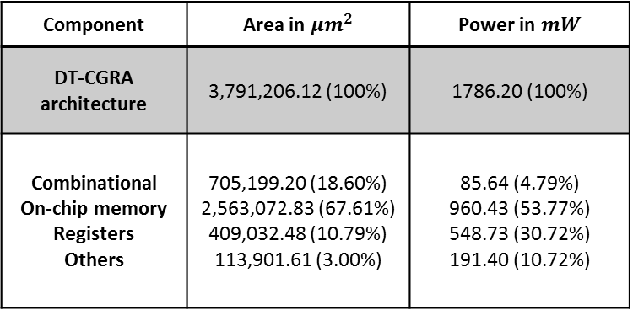
Experiments (1)
Implementation details
Synthesis | Synopsys Design Compiler
P & R | Synopsys IC Compiler
Power Estimation | IC Compiler
Process | SMIC 55 nm
Component | Area in $μm^{2}$ | Power in $mW$
DT-CGRA architecture | 3,791,206.12 (100%) | 1786.20 (100%)
Combinational On-chip memory Registers Others | 705,199.20 (18.60%) 2,563,072.83 (67.61%) 409,032.48 (10.79%) 113,901.61 (3.00%) | 85.64 (4.79%) 960.43 (53.77%) 548.73 (30.72%) 191.40 (10.72%)
Delay of critical path: 1.95ns;
1.79W @ 500MHz
78% in area
84% in power consumption

Slide 25
Experiments (2)
Evaluation methods
SVM
Softmax
Joint Bayesian
A general flow of object detection/inference:
Feature extraction
Feature selection
Inference
Results: person, pedestrian
HOG
CNN
k-means
SPM
PCA

Slide 26
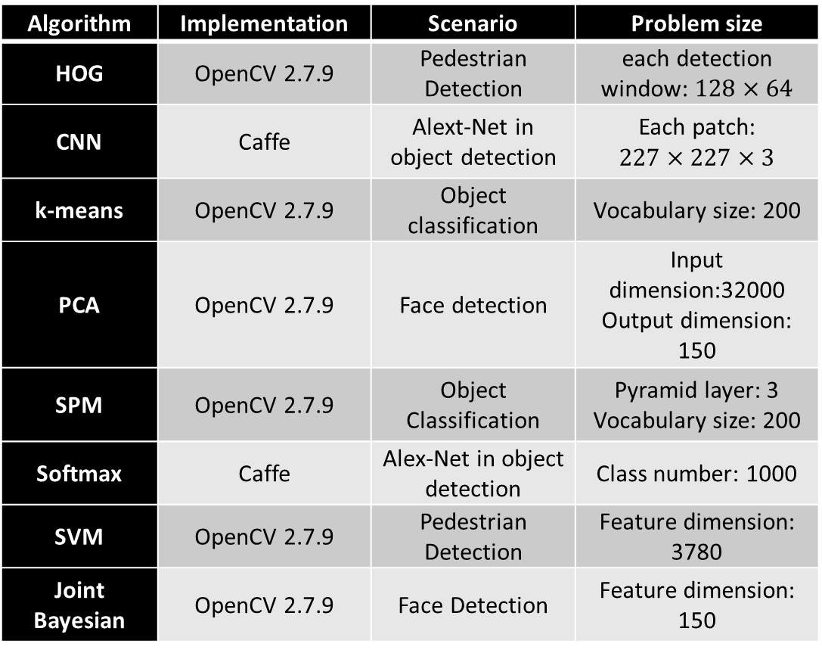
Experiments (3)
Algorithm | Implementation | Scenario | Problem size
HOG | OpenCV 2.7.9 | Pedestrian Detection | each detection window: $128×64$
CNN | Caffe | Alext-Net in object detection | Each patch: $$227×227×3$$
k-means | OpenCV 2.7.9 | Object classification | Vocabulary size: 200
PCA | OpenCV 2.7.9 | Face detection | Input dimension:32000 Output dimension: 150
SPM | OpenCV 2.7.9 | Object Classification | Pyramid layer: 3 Vocabulary size: 200
Softmax | Caffe | Alex-Net in object detection | Class number: 1000
SVM | OpenCV 2.7.9 | Pedestrian Detection | Feature dimension: 3780
Joint Bayesian | OpenCV 2.7.9 | Face Detection | Feature dimension: 150
Evaluation methods
CPU implementation:
Intel i7-3770 (3.4GHz)
Single thread
Power: 77 W

Slide 27
Experiments (3)
CPU vs. DT-CGRA
(1) Speedup of the design architecture
(2) Energy consumption of CPU over the design architecture
Average speedup: 38.86x
Average energy reduction: 1442.7x

Slide 28
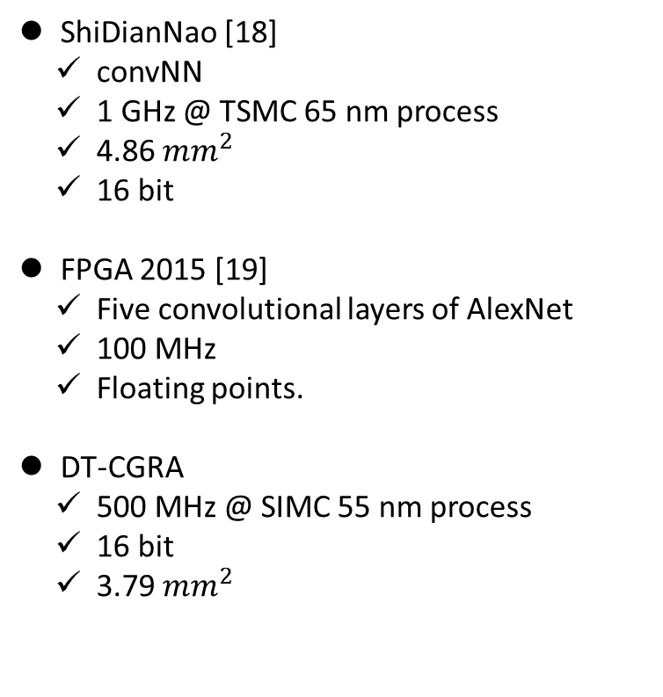
Experiments (4)
DT-CGRA vs. Application specific architectures
Roughly comparison results
Solution on convNN | Time (ms) | Power (W) | Peak Peformance (GOP/s) | Energy-efficiency
ShiDianNao [18] | 0.047 | 0.32 | 194 | 6.90x
DT-CGRA | 0.058 | 1.79 | 95 | 1x
Solution on Alex-Net (five convolutional layers) | Time (ms) | Power (W) | Peak Peformance (GOP/s) | Energy-efficiency
FPGA2015 [19] | 21.61 | 18.61 | 61.62 | 1x
DT-CGRA | 28.72 | 1.79 | 95 | 7.82x
ShiDianNao [18]
convNN
1 GHz @ TSMC 65 nm process
4.86 $mm^{2}$
16 bit
FPGA 2015 [19]
Five convolutional layers of AlexNet
100 MHz
Floating points.
DT-CGRA
500 MHz @ SIMC 55 nm process
16 bit
3.79 $mm^{2}$

Slide 29
Summary
Propose a dual-track programming model for CGRA
Pseudo static configuration is to determine the functionalities of mapped RCs.
Dynamic configurations are to manage data streams.
Propose a CGRA architecture for stream applications based on the above model.
The RC is a cluster of multipliers and ALUs.
Decomposition and combination of RCs can be supported for flexibility of configurations.
The proposed CGRA is evaluated by the machine learning.
Average speedup and energy reduction is 39x and 1443x respectively comparing to CPU implementations.

Slide 30
Thank you!

Slide 31

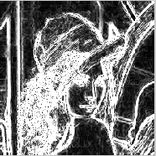
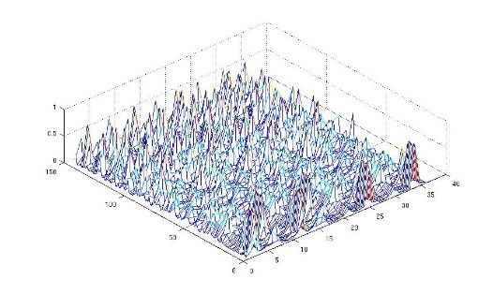

Appendix (1)
Observations from object detection/classification domain:
Classical feature extraction algorithms: HOG
-1
Feature map
-1
1
0
0
1
cell
Two overlapping blocks
Feature vector
$$f=[…,…, ,…]$$
Compute gradients
Accumulate weighted votes for gradient orientation over spatial cells
Normalize contrasts within overlapping blocks of cells
Stage 1
Stage 2
Stage 3
Stage 1
Stage 2
Stage 3
Stage 1
This abstraction can be applied to Dense-SIFT, DPM algorithms
The whole algorithm
Stage 2
Stage 3

Slide 32
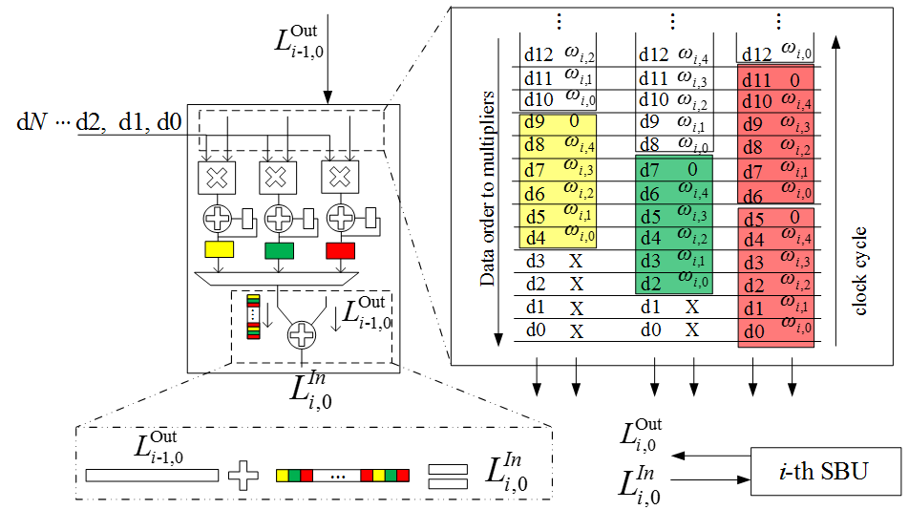


Appendix (2)
Convolution in CNN:
one of the computing strategies
Kernel size: $5×5$; stride: 2.
#Phase 0
$$i=0,1,2$$
#Phase 1

