Slide 1
Connect On the Fly: Enhancing and Prototyping of Cycle-Reconfigurable Modules
Hao Zhou∗, Xinyu Niu†, Junqi Yuan∗, Lingli Wang∗, Wayne Luk†
†Dept. of Computing, Imperial College London, UK
∗School of Microelectronics, Fudan University, China

Slide 2
Outline
motivation
EURECA architecture
Architecture optimisation
results
summary

Slide 3
Summary of Contributions
1. Reconfiguration strategies for data access patterns
Three categories for dynamic data accesses
Reconfiguration modes: maximise configuration sharing
2. Architecture design space exploration
Multiplexers or permutation network
Optimal EURECA module size
3. Prototype chip layout
Manually developed with SMIC 130-nm technology
Results measured using Cadence tools

Slide 4
Static vs dynamic data access
conditional arithmetic operators
dynamic data access patterns
for (i=0; i<n; i+=N)
#parallel unroll N
for(j=0; j<N; j++){
k = i*N + j;
d[k] = a[k+1] * c[k];
}
for (i=0; i<n; i+=N)
#parallel unroll N
for(j=0; j<N; j++){
k = i*N + j;
d[k] = a[b[k+1]] * c[k];
}
static: easy
dynamic: hard
Notes:
Static operations with deep pipeline suitable for FPGA, like the one on the left
Dynamic operations, which reply on runtime values to decide which operation to run, are hard to support in FPGAs, like the one on the right

Slide 5
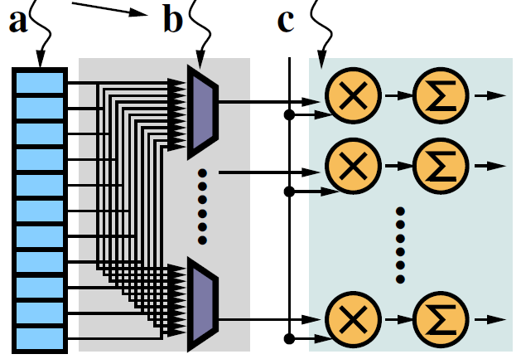
Example: dynamic data access
d
for (i=0; i<n; i++) {
d[k] = a[b[k+1]] * c[k];
}
C
connections for
one data-path: easy

Slide 6
Example: dynamic data access
for (i=0; i<n; i+=N)
#parallel unroll N=32
for(j=0; j<32; j++){
k = i*32 + j;
d[k] = a[b[k+1]] * c[k];
}
connections for
32 data-paths: hard

Slide 7
Implementation 1: multiplexors
congested routing
1024-to-1024 bit connections
unroutable in XC6V-SX475T
expensive user multiplexers
d
32 output ports, each 32-bit wide

Slide 8
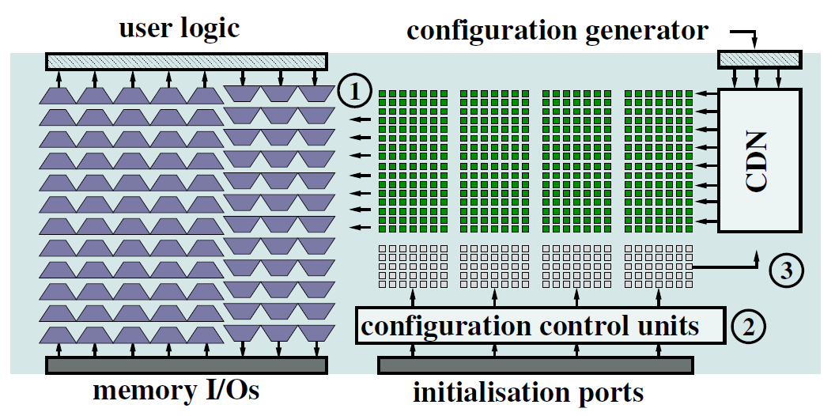
EURECA module: execution flow
Initial configuration
CDN: Configuration Distribution Network
Initial configuration
Notes:
EURECA architectures take a different way: at each cycle, we only implement what’s needed
Circuits are configured cycle by cycle

Slide 9
EURECA module: execution flow
CG: Configuration Generator
Data-paths
CG
Initial Connections

Slide 10
Run-time reconfiguration flow
CG
Runtime configuration
Initial Connections

Slide 11
Run-time reconfiguration flow
CG
Initial configuration

Slide 12
Run-time reconfiguration flow
data-path data
CG
Initial configuration
memory data

Slide 13
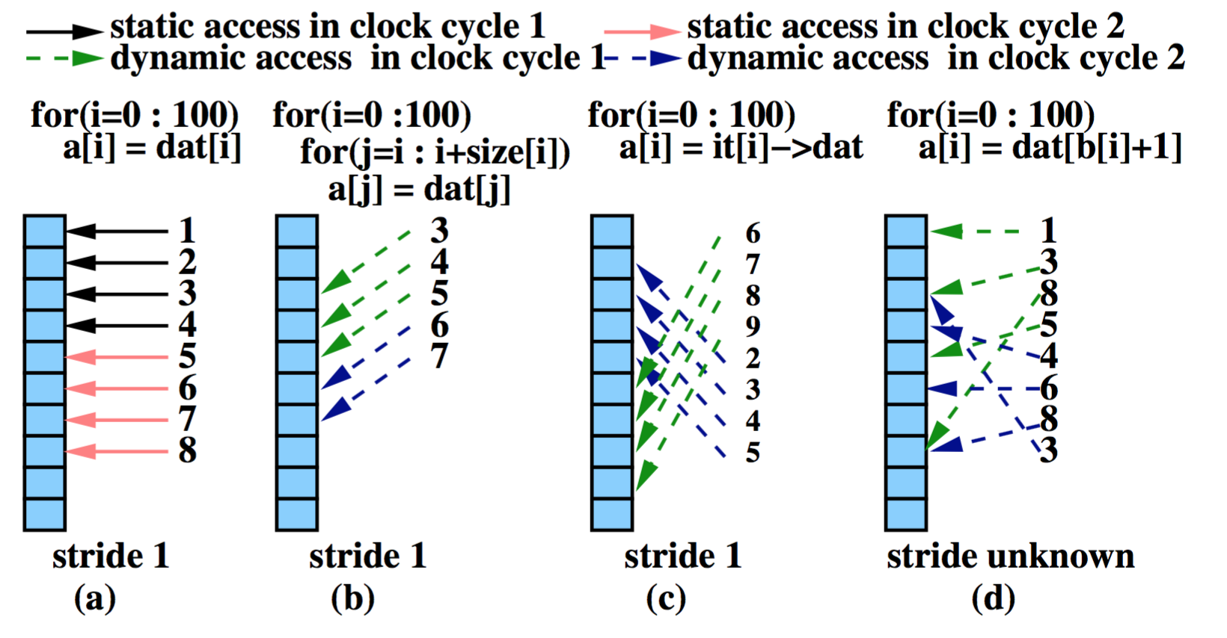
1. Optimising Data Access Patterns
Static (a): accesses with fixed strides
Dynamic size (b): linear accesses with variable vector size
Dynamic offset (c): vector access with dynamic offsets
Random (d): each access with a dynamic offset
Notes:
In this work, we put data access into 4 categories
The dynamic accesses have three patterns:
Each vector access has different data size (in figure, 3 bytes in cycle 1, 2 byes in cycle 2)
Each vector access has different starting point (in figure cycle1 starts from the 6th byte, cycle2 starts from the 2nd byte)
Each scalar access has random access location

Slide 14
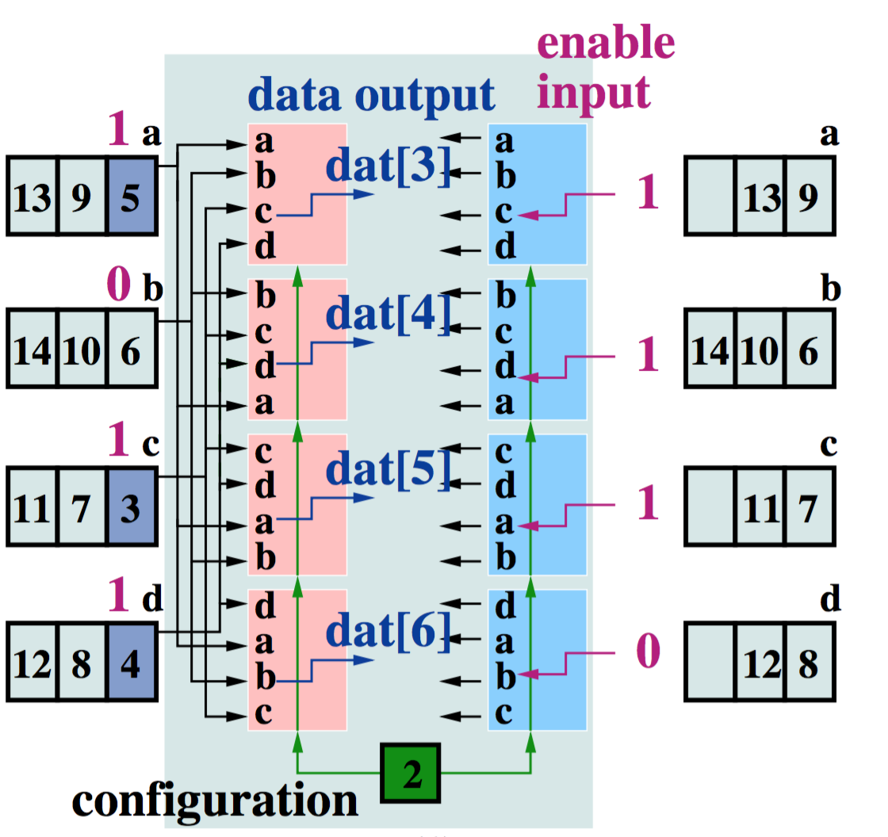
Dynamic FIFOs
Dynamic size → Dynamic FIFOs: BRAMs organised as FIFOs
A single configuration is shared by all runtime reconfigurable connections in a EURECA module
Enable signals to FIFOs are dynamically connected to corresponding FIFO ports
Notes:
As data are always accessed in order (3,4,5,6,7,8….), we use FIFOs here
FIFOs are connected with EURECA modules
In this example, 3, 4, 5 need to be committed from the FIFO, access start from the 3rd memory port (3)
After the commitment, the data appear at the FIFO output ports are 9, 6, 7, 8
Access needs to start from the 2nd memory port (6)
Runtime reconfiguration is needed
To share configuration, we can order the connections in the way such that under the same configuration, the memory ports are connected in order:
For example, when configuration sets each connection to select its first input.
The first connection (pink module) connects to 1st memory port
The second connection (pink module) connects to 2nd memory port
Therefore, the whole EUREC module only needs 1 runtime configuration
This significantly reduces the logic to generate runtime configurations

Slide 15
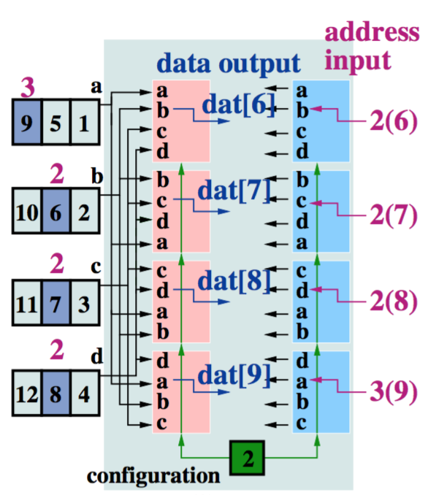
Dynamic cache
Dynamic offset →Dynamic cache: BRAMs as shared cache
Single configuration shared by all runtime reconfigurable connections
Input address to BRAMs are dynamically connected
Notes:
Similar here, the only difference is that since vector data are not accessed in order, each memory port needs its address input instead of FIFO read enables
Configurations can be shared in the same way

Slide 16
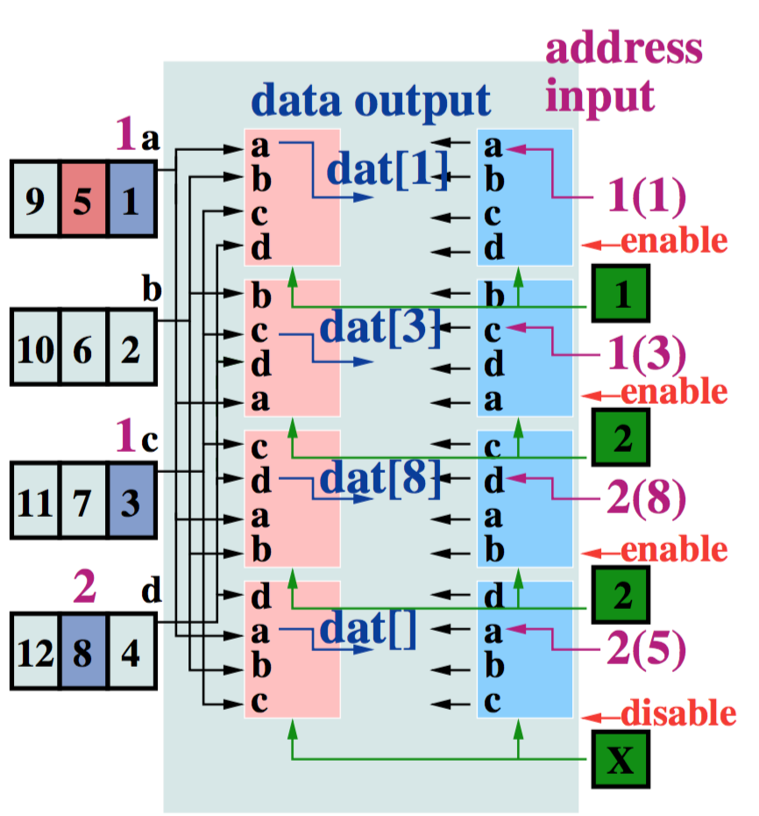
Dynamic shared cache
Random → Dynamic shared cache: access conflicts
Access conflicts happen when 2 or more data-paths try to access the same port at the same time: the lower two data-paths in the figure
Each reconfigurable connection has a separate configuration
Conflicted ports (the lowest data-path) are disabled by scheduler
Notes:
For random access, to avoid runtime conflicts, a scheduler is needed to disable invalid runtime reconfiguration
Configurations cannot be shared for this case, each memory port has its own runtime configuration

Slide 17
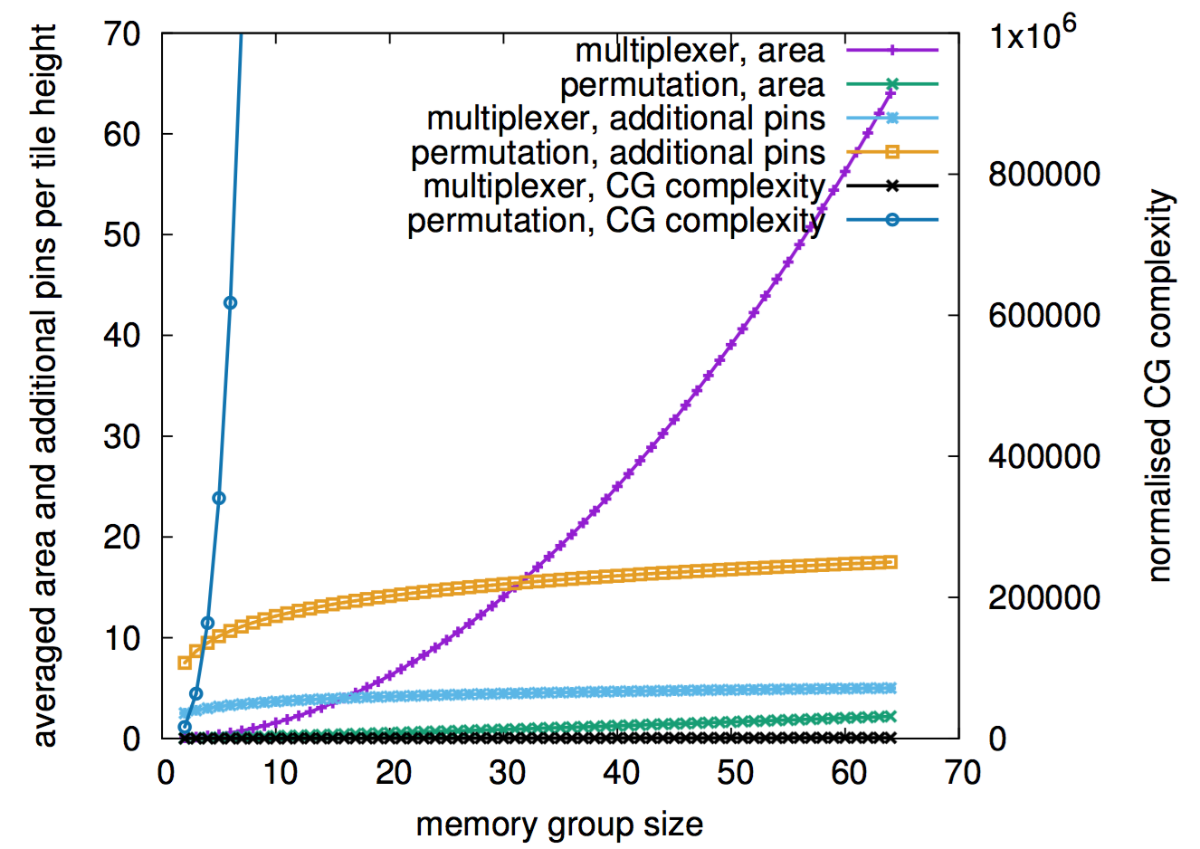
2. Optimising Connection Network
Multiplexers or permutation network?
Three parameters to evaluate:
Number of pins to support runtime reconfiguration
Silicon area to implement the network
Logic required to generate runtime configurations for the network

Slide 18
Connection Network
Multiplexers or permutation network?
Multiplexers are selected as configurations can be shared
To reconfigure a permutation network within a single cycle takes an unacceptable amount of pins and configuration generation logic
Notes:
Permutation network has less area usage since the connections are split into multiple layers
However, these multiple layers are much more complicated to configure, and the runtime configurations cannot be shared
End up with too many pins to input all runtime configurations in a single clock cycle, and a huge configuration generator

Slide 19
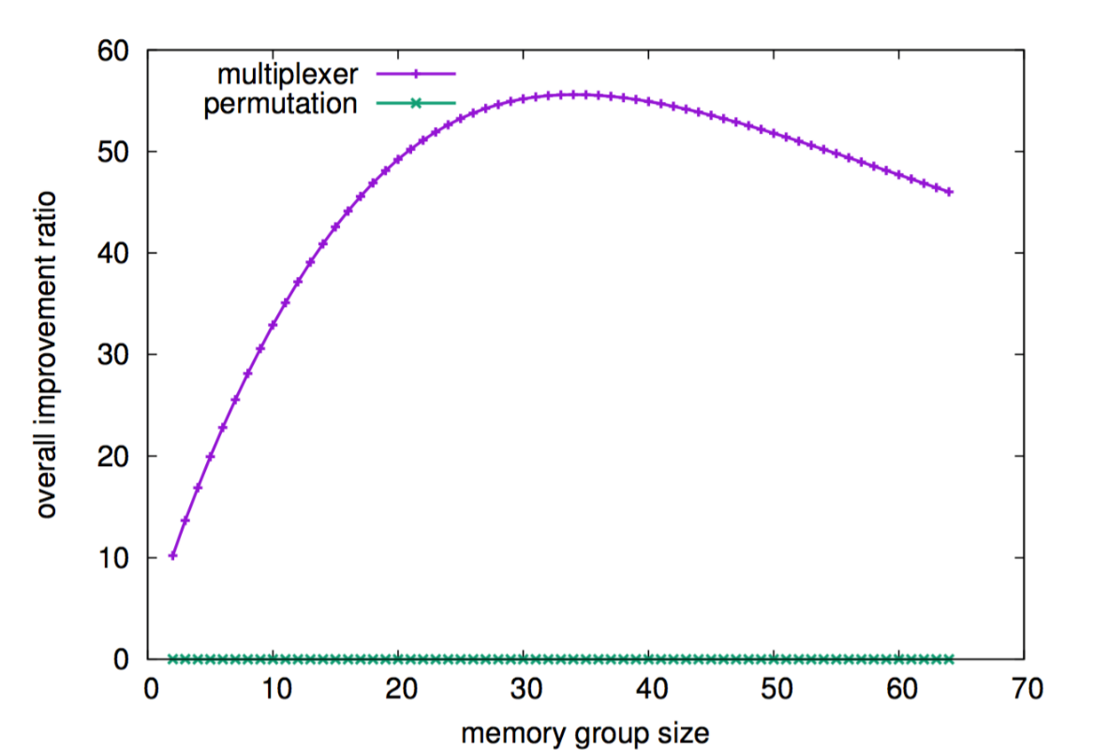
Architecture Efficiency
Architecture efficiency is evaluated with the area saved by runtime reconfiguration, multiplied by overall area overhead
Original application resource usage
Original chip area
Runtime reconfigurable application resource usage
EURECA chip area

Slide 20
EURECA Optimisation
Connection network: multiplexers or permutation network
Memory group size: the number of BRAM blocks connected to a single EURECA module
Circuit models for application area reduction and module area
Small memory group size: small reductions in design area
Large memory group size: large module area overhead
Efficiency reaches maximum at 32 BRAMs, supported by circuit models

Slide 21
3. EURECA Prototype
Prototype layout developed with SMIC 130-nm technology
Classic island-style FPGA architecture adapted
Small FPGA size due to tape-out budget
A single EURECA module added to one column of BRAMs (8)
Prototype layout developed with SMIC 130-nm technology
A EURECA module is the same area as 2.72 CLB columns
A EURECA module brings 1.15ns delay (typical circuit critical path delay on this architecture 20-40 ns)

Slide 22
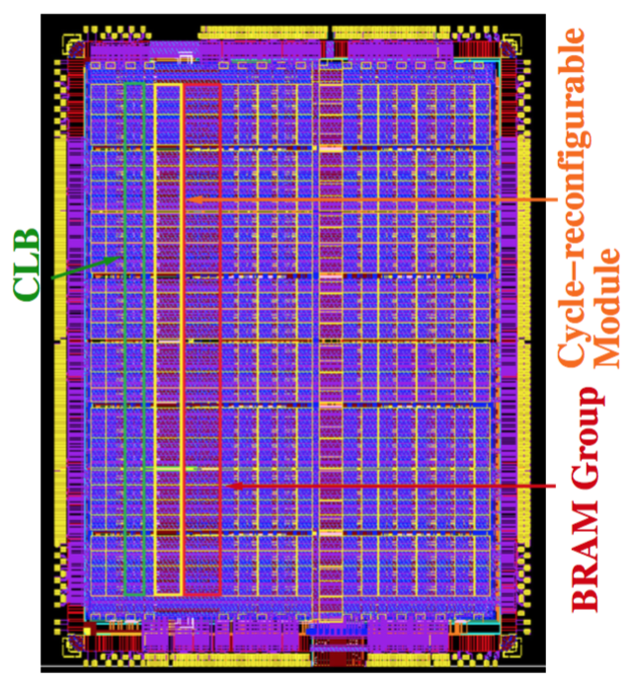
EURECA Prototype

Slide 23
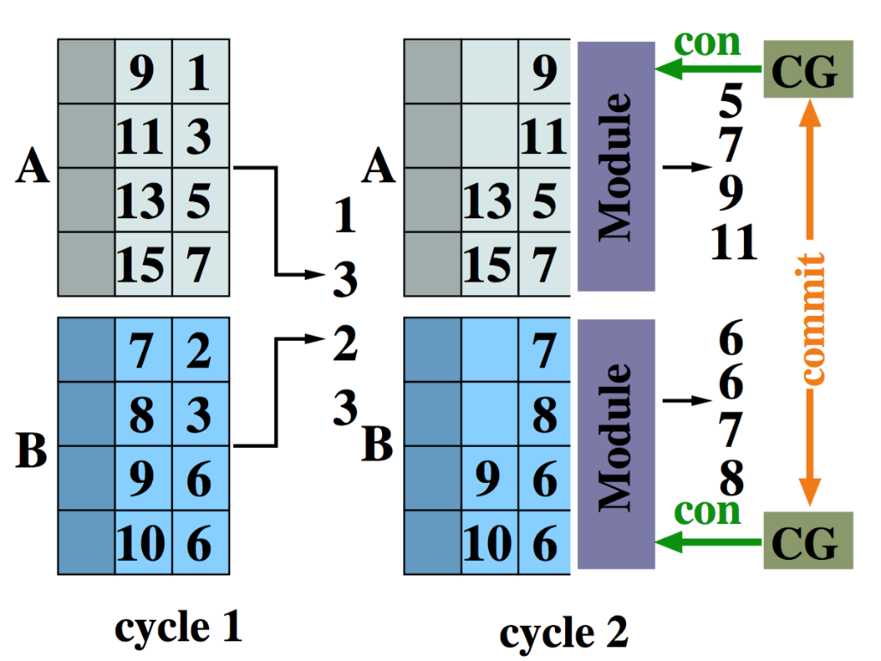
Application 1: Large-scale Sorting
Large-scale sorting: dynamic FIFOs
At each cycle, there are unknown amount of values committed from each FIFO
The starting address changes from cycle to cycle
Notes:
Large-scale sorting, is one of the most extensively researched subjects because of the need to quickly organise millions to billions data items in a database.

Slide 24
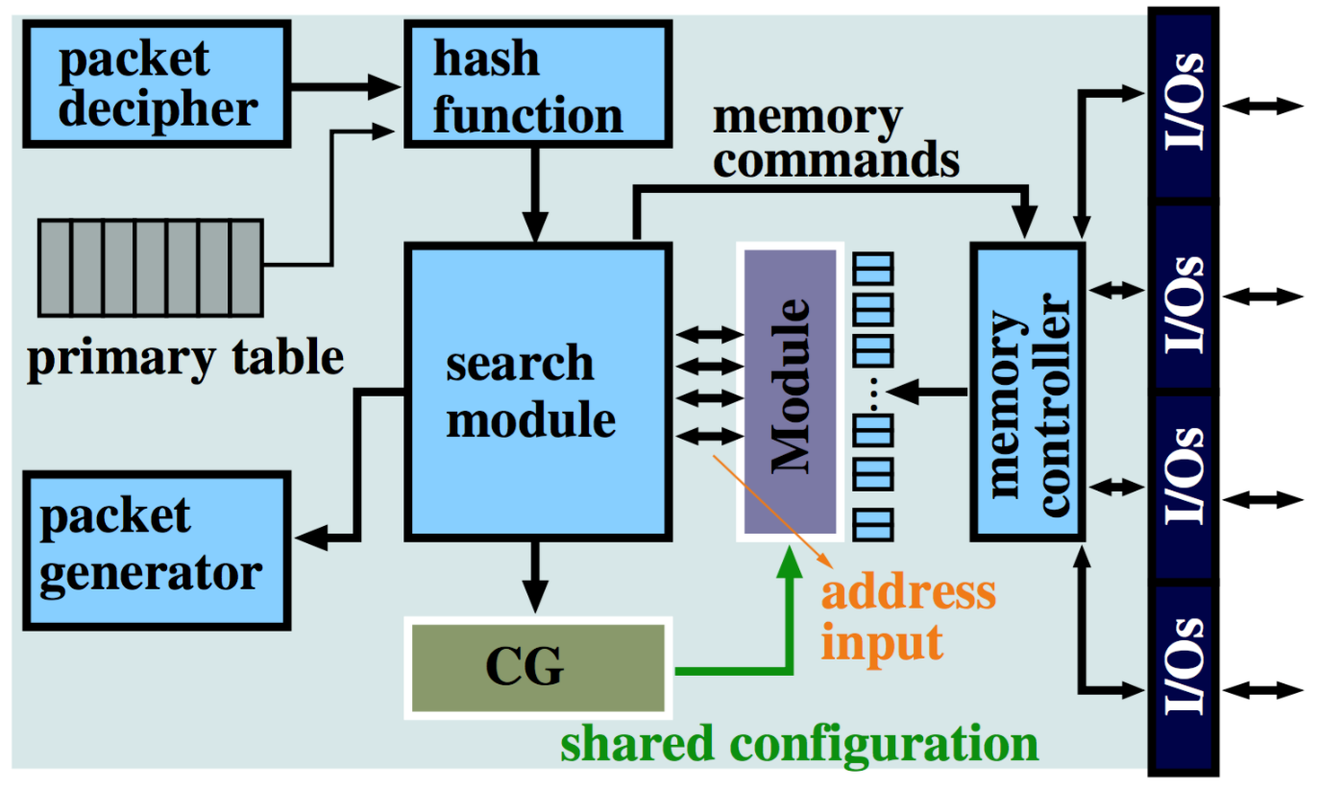
Application 2: Memcached
Memcached: dynamic cache
A vector data pointed by a dynamic pointer is read each cycle
The address changes from cycle to cycle
Notes:
Memcached, is a distributed memory caching system widely used in the servers of web service companies (Facebook, Twitter, YouTube, Wikipedia, etc.). A Memcached server stores frequently ac- cessed data in memory to provide quick responses to web requests.

Slide 25
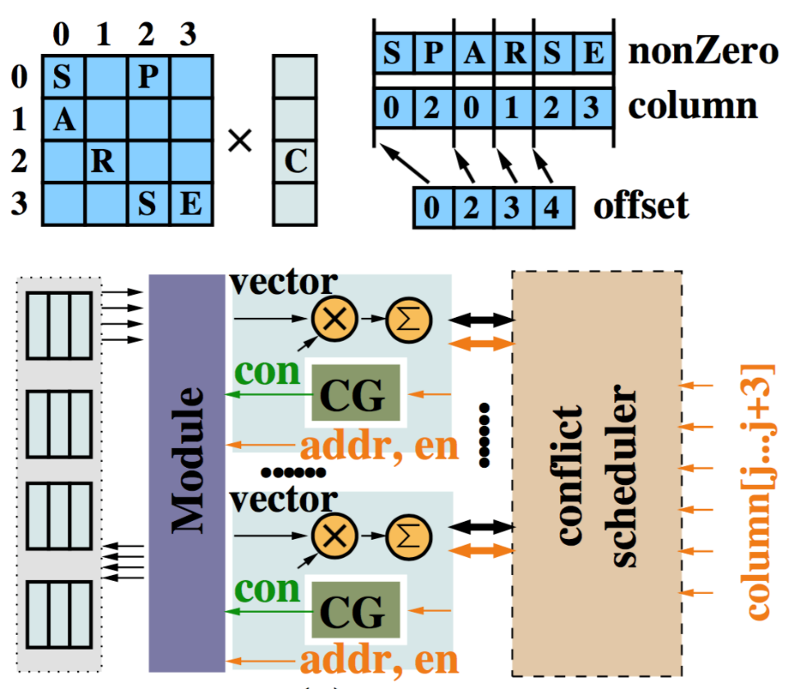
Application 3: SpMV
SpMV: dynamic shared cache
Accessed locations in the vector depends on the postion of non-zeros in the sparse matrix
Each vector access is random
A scheduler module to only enable one runtime reconfiguration for a memory port
Notes:
Sparse Matrix-Vector multiplication (SpMV), is widely used in scientific computing and industrial development. SpMV multiplies a sparse matrix with a dense vector,

Slide 26
Experimental Setup
Target chip
Prototype EURECA chip
Area, delay measured from Cadence simulation results
synthesis environment
Design Compiler (DC) for circuit synthesis
ABC for mapping
A graph matching algorithm for packing
Simulated annealing algorithm for placement
Path-finder for routing

Slide 27
Application Performance
Three implementations developed for each application
Static design use LUTs to support all dynamic data accesses
EURECA supports dynamic accesses with original architecture
Dynamic uses the optimised architecture, support maximum configuration sharing

Slide 28
Application Performance
Three implementations developed for each application
Up to 11.2 times area-delay reductions compared with static design
Up to 1.39 times area-delay reduction compared with original EURECA architecture

Slide 29
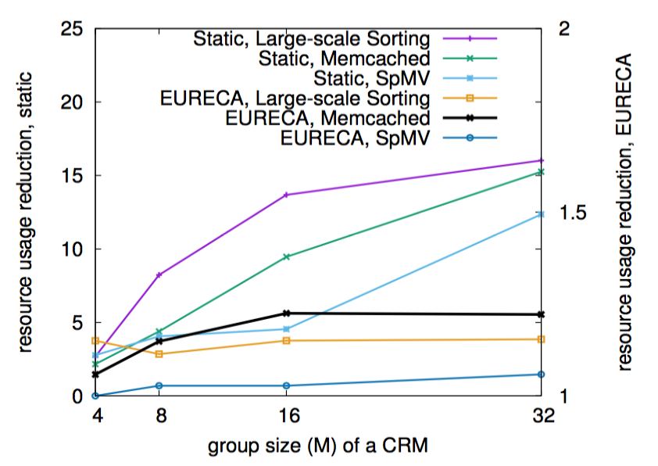
Application Performance
Area-delay reductions grows linearly as the number of BRAMs connected to a EURECA module grows
Area reduction increases to 16 for 32 BRAMs

Slide 30
Current and future work
EURECA full-stack compiler
EURECA programming models
operation mapping
data access mapping
many-region communication
EURECA simulator for architecture optimisation
Automatically explore design space with generated architecture files and Verilog modules

Slide 31
Summary: EURECA
Routing challenge: dynamic data access applications
Three data access patterns
Optimised reconfiguration strategies
Design space exploration and prototype layout
Experimental results: prototype layout + synthesis tool
small area and delay overhead
Application performance
up to 1/11.2x area-delay product compared with static architecture
up to 1/1.39x area-delay product compared with initial architecture

