Slide 1
EURECA Compilation: Automatic Optimisation of Cycle-Reconfigurable Circuits
Xinyu Niu, Nicholas Ng, Nobuko Yoshida and Wayne Luk
Dept. of Computing, School of Engineering, Imperial College London, UK
Tomofumi Yuki INRIA / LIP / ENS Lyon, France
Shaojun Wang
Harbin Institute of Technology, China

Slide 2
EURECA Overview
conditional arithmetic operators
dynamic data access patterns
for (i=0; i<n; i+=N)
#parallel unroll N
for(j=0; j<N; j++){
k = i*N + j;
d[k] = a[k+1] * c[k];
}
for (i=0; i<n; i+=N)
#parallel unroll N
for(j=0; j<N; j++){
k = i*N + j;
d[k] = a[b[k+1]] * c[k];
}
static: easy
dynamic: hard

Slide 3
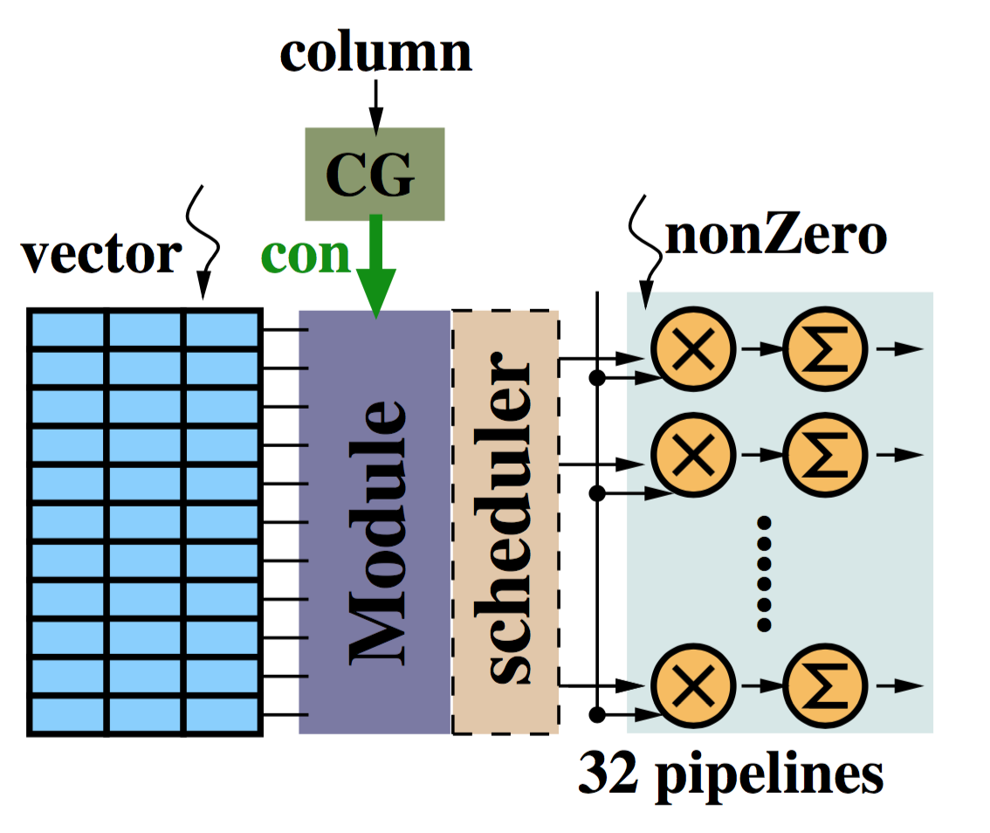
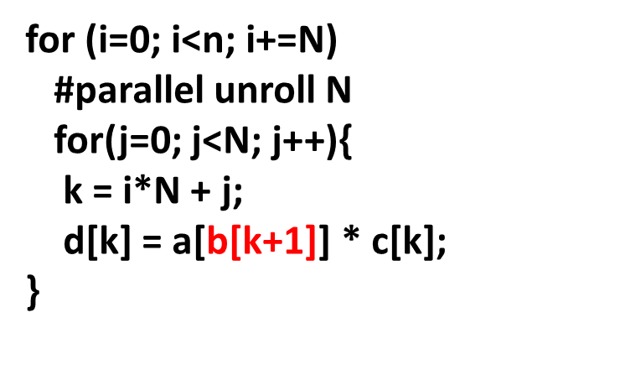
EURECA Overview
adopt cycle-by-cycle runtime reconfiguration to support dynamic data access
At each clock cycle:
Configuration Generator takes dynamic pointers to calculate runtime configuration
Update circuit configuration in the EURCA module
Process accessed data through update connections
N=32, 32-bit data: 32 output ports, each 32-bit wide

Slide 4
EURECA Compiler
Detection of dynamic data access
Communication protocols for conflict-free access
Circuit model optimisation

Slide 5
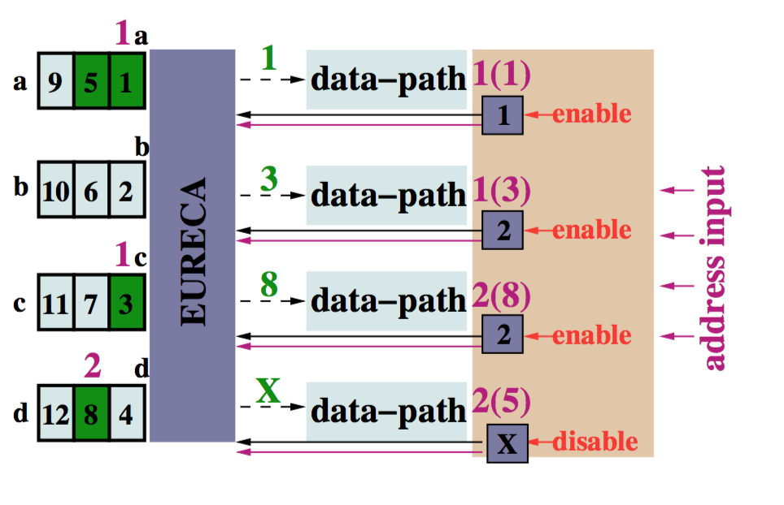
EURECA Compiler
Access conflicts happen when more than 1 data-paths try to connect to the same ports
Protocols based on session types ensure no conflicts happen during runtime reconfiguration
Scheduler automatically generated based on protocols
Protocols define access priorities for each port from each data-path

Slide 6
Results
Compiler infrastructure to support EURECA-based applications
Three benchmark applications tested:
- large-scale sorting
- Memcached
- Sparse Matrix Vector Multiplication (SpMV)
40% improvement over manually optimised EURECA designs, mainly due to configuration scheduling
Full-stack compiler under development
- Polyhedral frontend to analyse access parallelism
- Protocols to evaluate different priority strategies

